Slide 1
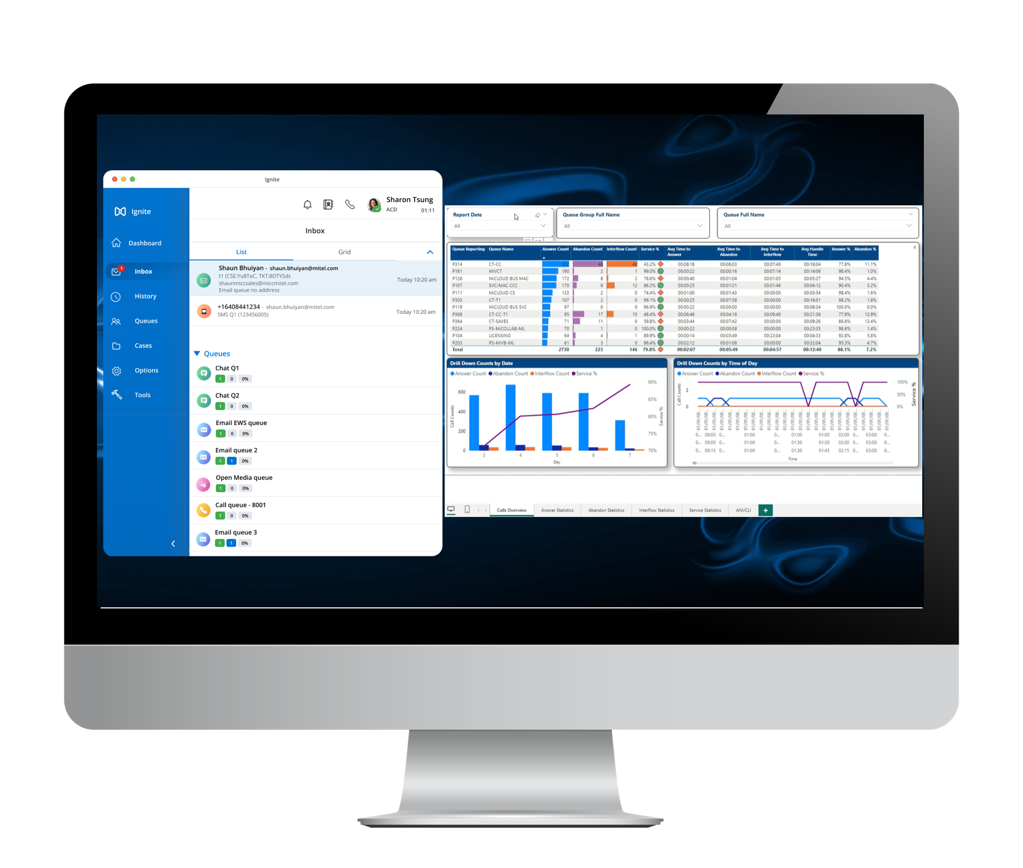
MIR/RI:
Mitel Interactive Recording & Recording Insights
Analytics & AI
Jeff Potter, Director of Channel Sales (ASC)
October 16, 2024
Notes:
Karen presents

Slide 2
Mitel Interaction Recording

Slide 3









Mitel Workforce Optimization Suite
Continuous
Customer
&
Employee
Experience
Improvement
INTERACTION
RECORDING
BUSINESS INTELLIGENCE
QUALITY
MANAGEMENT
Mitel
Workforce Optimization
PERFORMANCE
MANAGEMENT
COACHING AND
LEARNING
WORKFORCE
MANAGEMENT
SPEECH
ANALYTICS
ARTIFICIAL INTELLIGENCE (AI)

Slide 4
The latest things you should know about MIR
MiVCR to MIR migration model in CPQ has been updated to isolate the quote to qualifying migration parts only and calculate the minimum 1 Year MIR SWA required
  Optional full price add-ons must be quoted only after the SLS voucher for the migration order has been registered
  Ensures the price quoted for the add-on and associated SWA will align with the system it is being added to
MiVCR to MIR migration orders must be processed before June 30, 2024. Make sure you place your migration order at least 2 weeks prior to June 30, 2024, to ensure it is processed in time before the migration program ends and MiVCR is end of life
MIR SWA renewal quoting continues to be sent to Partners from ASC and are to be purchased through Mitel as usual
Quoting for new product and associated SWA continues to be available in CPQ
  Customers on legacy WFO MIR will be migrated to MIR bundles on their next SWA renewal
  Capex SWA renewals will be generated from SLS
Brightmetrics integration – enables mutual customers to seamlessly access and use MIR's recording features within the Brightmetrics platform, enhancing their ability to analyze and optimize operations
Online user training available now
NEW!
Important!
No
Change
Coming in Q3 2024!
NEW!
NEW!
Notes:
As part of this collaboration, Brightmetrics, a trusted partner of Mitel will gain access to functionalities native to Mitel Interaction Recording (MIR), which is powered by ASC. This integration will enable mutual customers to seamlessly access and use ASC's recording features within the Brightmetrics platform, enhancing their ability to monitor, analyze, and optimize their call center operations.

Slide 5


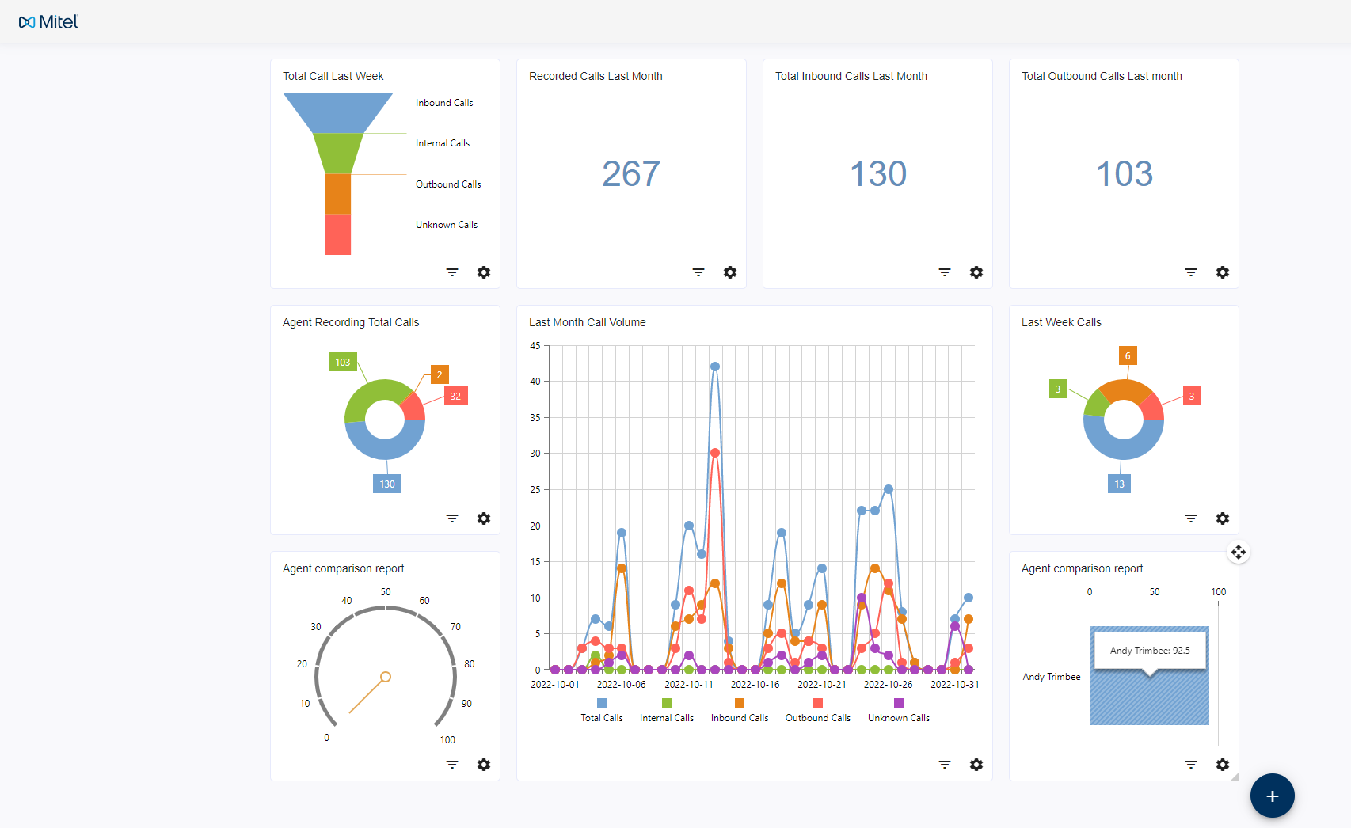
Mitel Interaction Recording
Quality Management Speech Analytics
AI
Notes:
Michael presents

Slide 6
Today, Customers have Risks, but
no Insights from their Customer Communication
Communication is being recorded to meet regulatory and quality demands.
Typically, a sample of those communication records is then manually checked for quality and compliance.
  Limited coverage, typically only 2-3% of calls
  Random call selection, not related to a specific profile of calls
  No extraction of business insights from those calls
  Tedious, repetitive labor, prone to human error
97%
Quality / Compliance RISK
0%
Business Insights

Slide 7

Using AI to
Enhance Customer Experience
Measure the script adherence of your agents
Identify calls with negative customer sentiment
Identify customers at risk of churn
Unearth inappropriate language and behavior
Auto-categorize calls
Provide automatic meeting summaries and extract action items
Grow
your
business

Slide 8
Applying AI to
Truly Understand All Customer Communication
De-risk
your business
Validating that all disclaimers have been said
Auto-categorizing regulated (e.g., FCA, MiFID, Dodd Frank, HIPAA) vs. non-regulated calls
Identifying calls that contain personal data
Auto-categorizing calls with PCI-DSS sensitive information (e.g., credit cards)
Identifying customer complaints
Unearthing inappropriate consulting

Slide 9

Recording Insights AI… Turns Communication Into Business Value
AI-driven analysis of the voice transcript
Automated scan for critical keywords, patterns and phrases
Use of predefined templates for rules, patterns or categories
Just ask – Azure OpenAI answers!
… and embedding above policies into workflows!

Slide 10

Automated Quality Management
Automatic Quality Management
Use the functionalities of Recording Insights AI to implement automatic quality management
Evaluate agents
Create scorecards and combine them with AI questions, adherence phrases, and patterns to evaluate your agents
Overview of the results
With the automatic evaluation you get results and an overview of 100% of the calls
Reporting
Use these insights to create meaningful dashboards and reports and improve the quality of your contact center

Slide 11

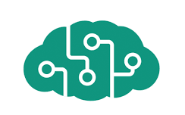
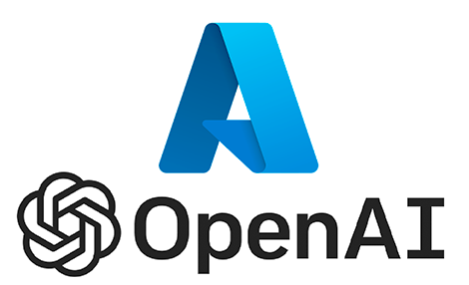

The Power of AI at Your Fingertips…
Secured in Microsoft Azure
Data processing only within Microsoft environment, data is secured in Azure infrastructure
Geodiversity: Analyze your data in your Azure region*
Keep full control of your data: Your data is not used to train or enrich foundation OpenAI models
Be safe: Built-in responsible AI to detect and mitigate harmful use
Be secure: Benefit from Microsoft infrastructure security and compliance
Transcription, translation,
keyword spotting, pattern recognition…
Azure AI Services
Question-based content analysis leveraging GPT
*subject to Microsoft availability

Slide 12

Mitel Interaction Recording &
Recording Insights AI…
… more than just recording!
Recording Insights AI
works on top of a customer’s existing call recording solution
Integrates easily with Mitel Interaction Recording (MIR)
Use the recordings of MIR to get deeper business insights using analytics and AI functionalities of Recording Insights
Visualize the insights into meaningful dashboards and reports to make the right decisions

Slide 13
Q&A

