Slide 1
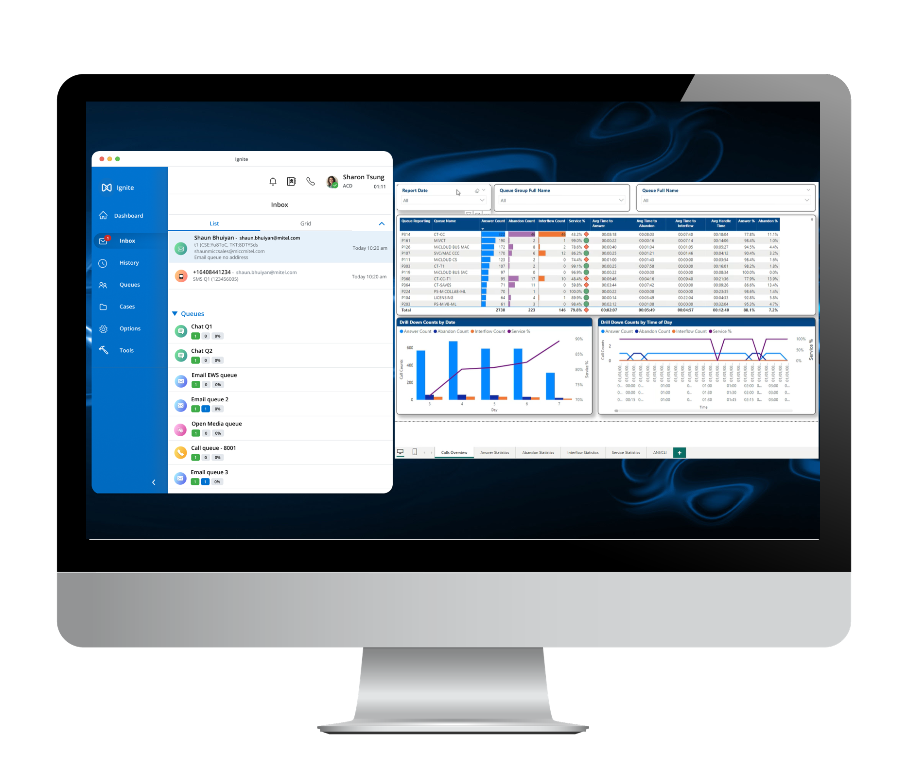

Call Recording & AI Analytics
September 2025
Tommy Tourk, Sr. Solutions Consultant
Michael Broderick, Director of Sales, East

Slide 2


Tommy Tourk, Sr. Solutions Consultant
Introductions
SMB Offering
Quality Management (Recording Insights)
FAQ’s for SMB / Recording Insights
Recording Insights Demo
Conclusion
Agenda

Slide 3

Mitel Interaction Recording &
Recording Insights AI …
… Optional Add-on to MIR
Insights AI works on top of a customer’s existing MIR
Integrates easily with Mitel Interaction Recording (MIR)
Use the recordings of MIR to get deeper business insights by applying analytics and the AI functionalities of Recording Insights AI
Visualize the insights leveraging meaningful dashboards and reports to make the right decisions

Slide 4









Mitel Interaction Recording Insights AI
High-Level Technical Overview
Search & Replay
Analytics
Azure AI
MIR
analysis
transfer
Blob Storage
Recordings from MIR will be automatically transferred to Recording Insights AI for analytics.
Transcription and AI based analytics will be carried out in Recording Insights AI.
Recording Insights AI will be the single UI for AI configuration, dashboards, search and replay, as well as the display of analytics results.
User to user mapping is mandatory.
Translation is available.

Slide 5
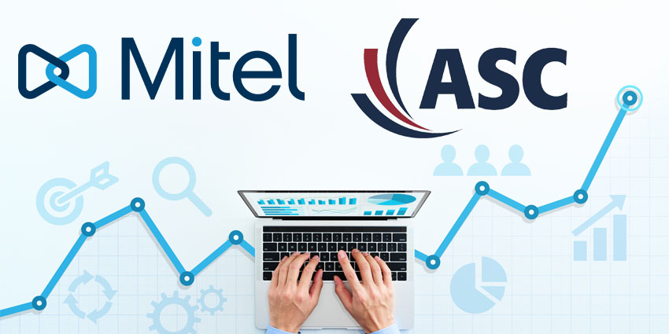
Quality Management

Slide 6

Today, Regulated Customers have Risks, but
no Insights from their Customer Communication
Communication is being recorded to meet regulatory demands.
Typically, a sample of those communication records is then manually checked for compliance.
  limited coverage, typically only 2-3 percent of calls
  random call selection, not related to risk profile of call
  no extraction of business insights from those calls
  tedious, repetitive labor, prone to human error
97 %
Compliance RISK
0 %
Business Insights

Slide 7





Quality Management: Automate Efficiency & Accuracy
ENSURE TOP SERVICE STANDARDS
MEET COMPLIANCE STANDARDS
Key to maintaining high service levels
Directly improving customer satisfaction
Enhances operational efficiency
Fulfills legal requirement to ensure compliance
Avoid penalties
BOOST EFFICIENCY
STAY COMPETITIVE
Identifies inefficiencies
Reduces errors
Minimizes the need for repeat interactions​
Rising customer expectations
Increasing competition
7

Slide 8

Quality Management: Essential for Superior Customer Service
Challenges of Manual Quality Management
Benefits of Automated Quality Management
-
Subjectivity
Varying assessments by different evaluators.
Resource-Intensive
Requires significant time and manpower.
Inconsistent ROI Measurement
Difficult to quantify results.
Potential for Errors
Issues may go unnoticed.
Consistency & Objectivity
AI-driven, uniform evaluations
Efficiency
Faster data analysis, reducing human effort
Cost-Effective
Better resource allocation, lower costs
Flexibility
Seamless integration into existing QM systems
-
-
-
8

Slide 9








Efficient & Easy: Automated Quality Management in 4 Steps
01
02
03
04
CREATING
SCORECARD
POLICY CONFIGURATION
EVALUATION & REVIEW
ACTIONABLE DASHBOARD
Choose manual or automated evaluation.
Define criteria and set up your QM scorecard.
Set policies from your scorecard, choose conversation types, and define monitoring parameters.
Automatically review, modify if needed, and use AI-driven insights for accurate evaluations.
Visualize agent comparison KPIs and leverage insights to drive ongoing improvements and optimize performance.
9

Slide 10
Today, Regulated Customers have Risks, but
no Insights from their Customer Communication
Real Life Example:
A company with 100 employees taking 20 calls per day, lasting 10 minutes each
  It’d be about 17 hours per week; 830 hours per year
    Nearly 84,000 hours/year of audio for all employees
  It would take 42 supervisors to review every minute
  AI is consistent, effective, not prone to human error
  Provide valuable insights to the nature of the calls from both a legal and business perspective
0 %
Compliance RISK
Valuable
Business Insights

Slide 11
FAQ’s: Quality Management & Recording Insights
What is the ideal market for the SMB?
Is Recording Insights available for the SMB Offering?
What happens to the data once in Recording Insights?
Does the customer need to purchase additional storage?
When is the data deleted?
How do I calculate packages?
11

Slide 12


