Slide 1

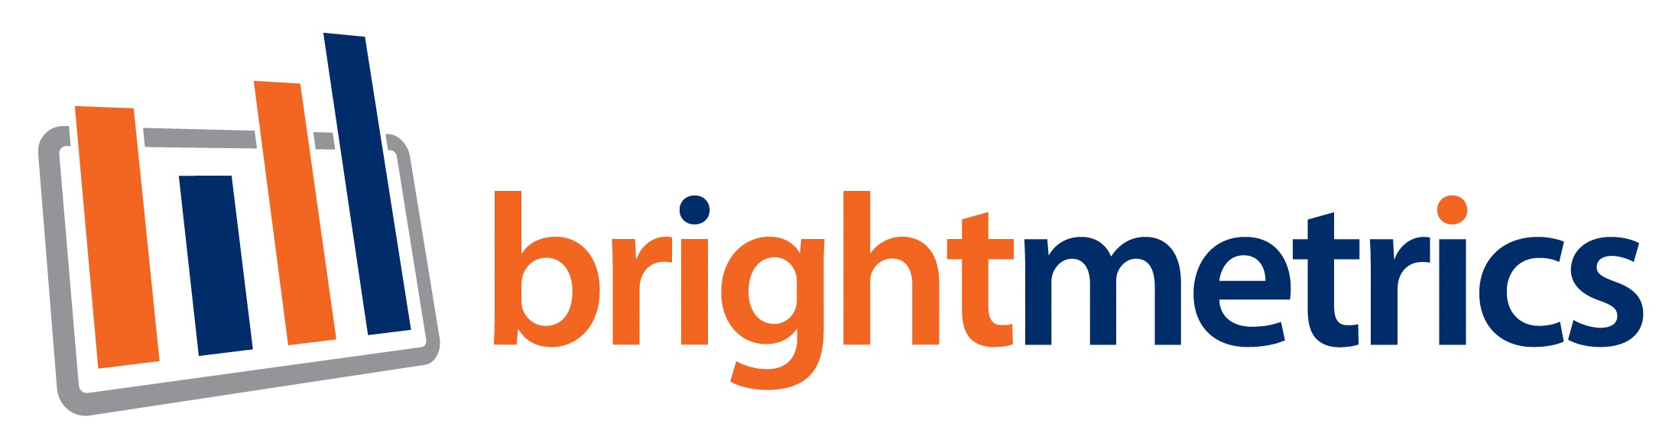
+

Slide 2

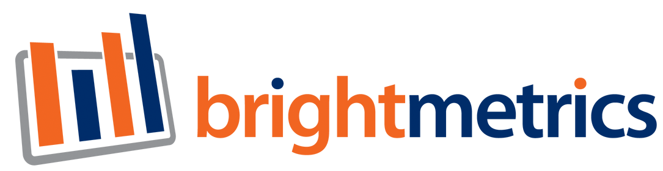
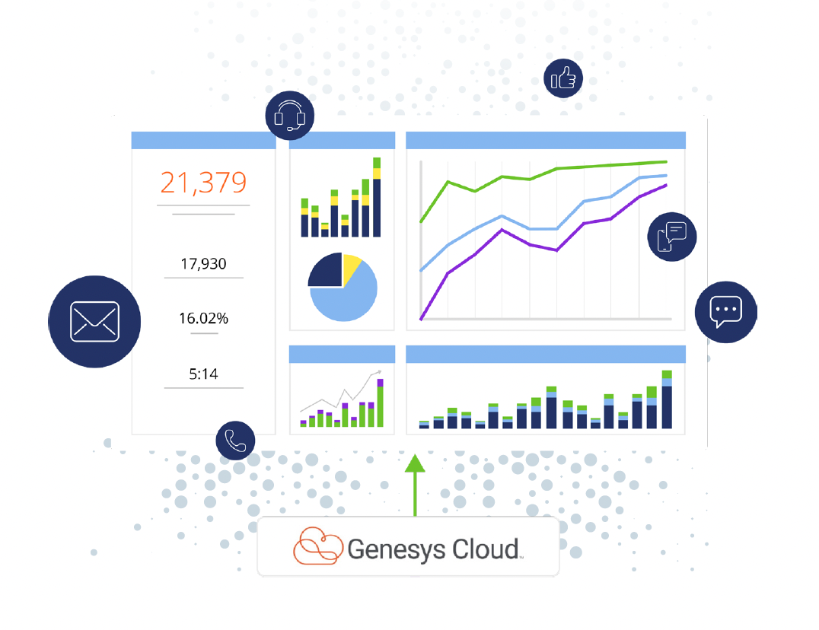





Brightmetrics: Reporting and Analytics for Mitel and RingCentral

Slide 3

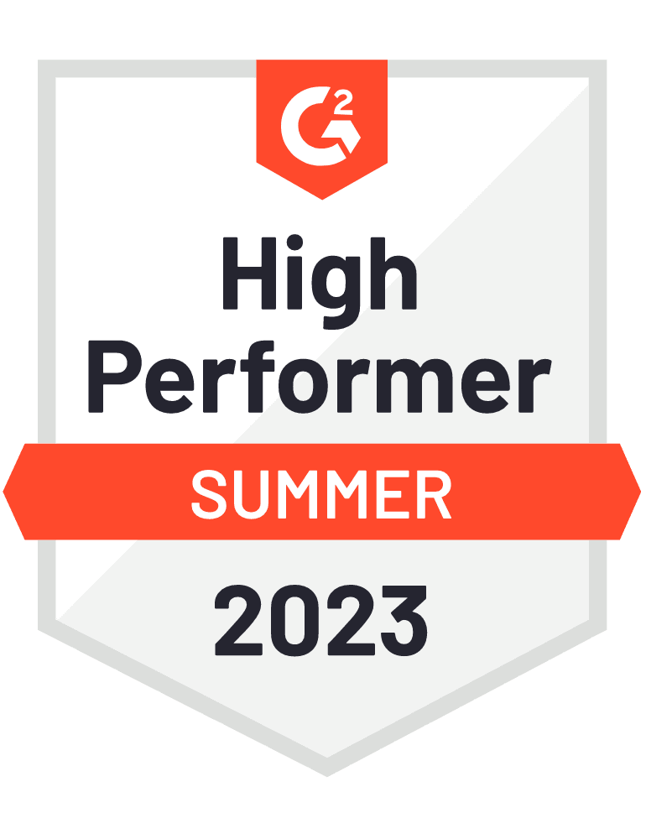




Brightmetrics?
A few shared customers:
Democratizing Access to Contact Center Analytics
About us:
  12+ years experience
  4,000+ Customers
  G2: ★ ★ ★ ★ ★
  NPS: 65
“Best analytics and reporting solution….”
- Henry S., G2
“A real game changer!”
- Maher M., G2
”Top notch product. Top notch service.”
- Terry O., G2 Reviewer

Slide 4



About Us
Speaker
Brightmetrics is an intelligent analytics platform designed to maximize UC and contact center performance and enhance the business value of your RingCentral and Mitel investments.
Brightmetrics delivers substantial ROI through:
  Driving superior customer experiences
  Boosting agent productivity
  Facilitating faster, data-driven decision-making
  Optimizing operational efficiency
Why Brightmetrics?
  Mitel MSA Partner
  RingCentral: Certified AppGallery Partner
  Key verticals served: SLED, Financial Services, Healthcare, Manufacturing, Retail, and more
Brian Olson
Account Executive, Brightmetrics​
bolson@brightmetrics.com

Slide 5
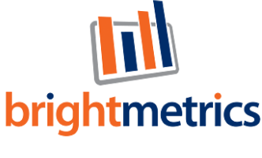
01
02
Quick Demo
03
04
05

Slide 6
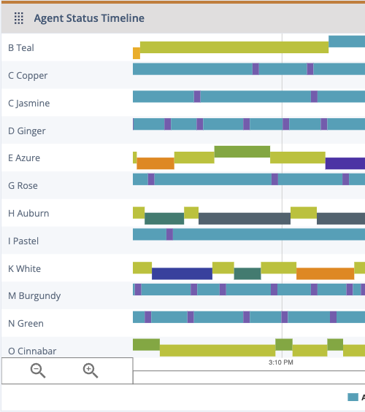
Key Takeaways
01
Single Pane of Glass: drill down through high-level dashboards and KPIs to detailed interaction data
02
Templates: start with the frequently used charts and edit to your liking
03
Automate: schedule reports and dashboards to be sent to various stakeholders
Shareable Dashboards: easily share dashboards with anyone, no additional licensing required
04
05
Flexible: customize reports & dashboards to align with your teams most important data points

Slide 7


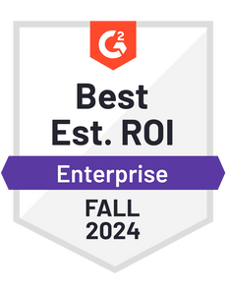

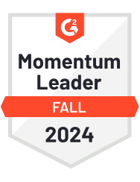


Thank You!
Brian Olson
707-971-7216
bolson@brightmetrics.com
www.brightmetrics.com
Try a 21-Day Free Trial (Installs in just 10 minutes!)

