Slide 1


Slide 2


TOP UC PROVIDER
in more than 10 MAJOR MARKETS
#1
UC Provider WORLDWIDE
5,000
Employees WORLDWIDE
#1
in DECT WORLDWIDE
80M+
GLOBAL USERS in more than 100 COUNTRIES
Today
#1
UC Provider WESTERN EUROPE
5,500+
Partners WORLDWIDE
#3
UC Provider North America

Slide 3
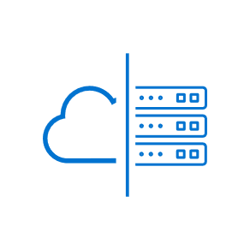





Current UC Market Dynamics
UCaaS is a segment NOT an evolutionary destination
HYBRID deployments predicted to be majority of market for foreseeable future.
Increasing demand for UC solutions specifically tailored to VERTICAL business needs
FRONTLINE workers out-number knowledge workers by 4:1. Underserved by current solutions but hard to find & key to success

Slide 4






Customer Owned
Partner Managed
Flexibility
Private or
Public cloud
AWS, Azure
Cloud-
assisted
apps &
features
& Choice
Subscription
CapEx
w/ SWA
Customer Owned
On-Prem
Partner Managed
Dedicated hardware,
VMware,
HyperV
Notes:
Flexibility and choice
A reliable, flagship Mitel product delivering world-class and flexible communications solutions for mid-market businesses​
Future proofing: Clear path to the cloud and opportunity to modernize, giving the customer a choice to migrate at their pace when they want​
Deployment flexibility: MiVoice Business delivers multiple deployment options ideally placed to fit unique customer technology strategy, including on-site, Hybrid, private or public cloud powered by AWS and Microsoft Azure​
Stay up-to-date with the latest security enhancements - drive opportunity to enhance business and create peace of mind for partners and customers

Slide 5
















Mitel’s Common Communications Framework
enables…
Vertical solutions
VCCS
OpenScape Xpert
Mitel Revolution
CEMS
COLLABORATION
DEPLOYMENT
CX SOLUTIONS
Tailored flexibility
Mix-and-match deployments
Options for frontline & back-office teams in a consistent experience
Enterprise scalability
Customer-Hosted Cloud
Communications
Mitel CX
Partner-Hosted Cloud
Mitel + Unify
Mitel
Secure Cloud
AI ECOSYSTEM
On-Prem
Notes:
George presents…. Pause for questions
Visual communicates the “openness” of the framework
Whatever solutions they choose, it’s a consistent experience throughout
Choice and optionality throughout
Starts with the core Mitel solutions > hosting options > works with whatever collaboration tool you need > and then the choose your own adventure expands beyond that with integrations

Slide 6





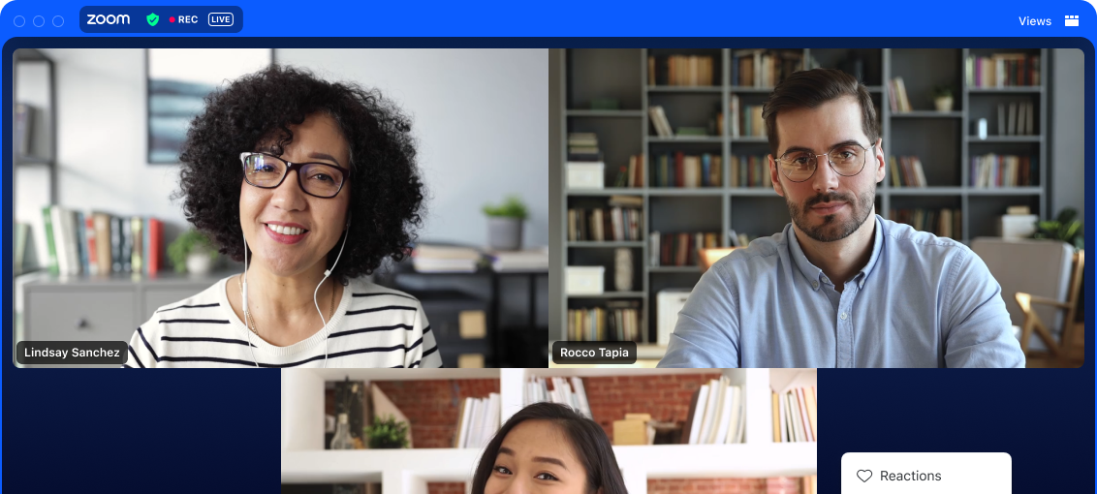
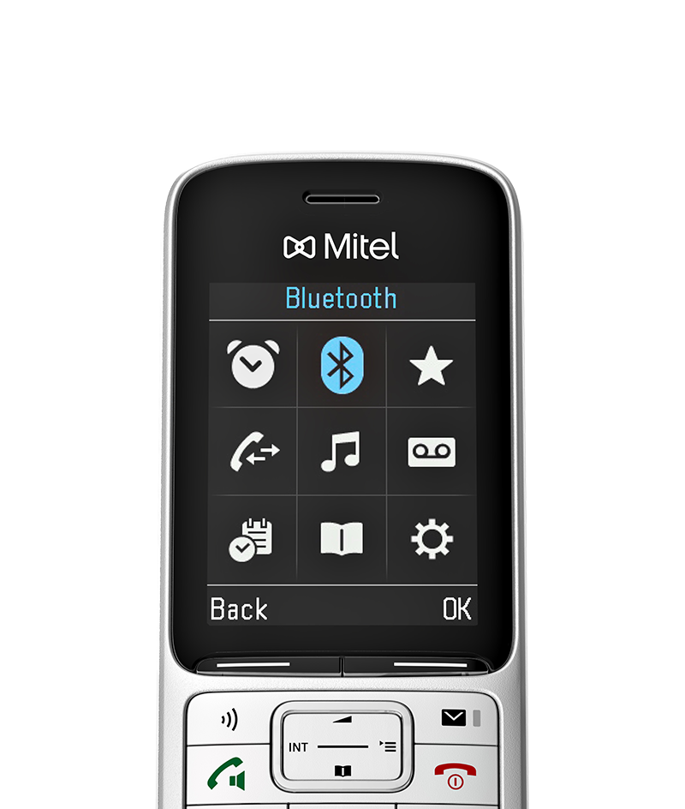

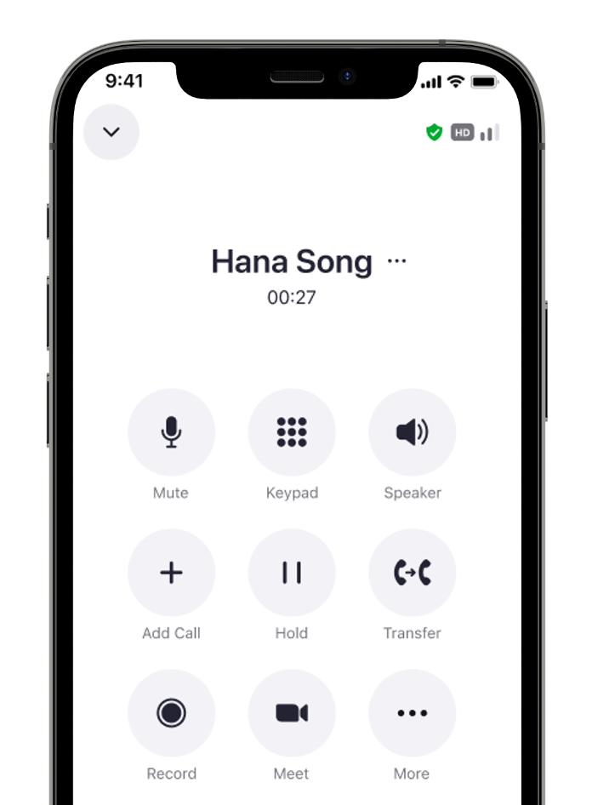
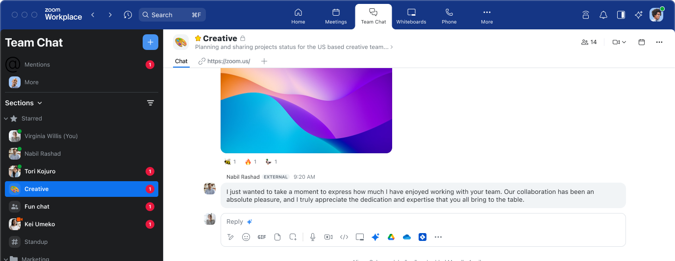
Call, chat, meet and more from anywhere
AI-powered communications that work together effortlessly with existing Mitel telephony and devices
Meetings
Team Chat
Mail & Calendar
Scheduler
Phone
Best-of-breed, trusted video meetings
Messaging, file sharing,
and continuous
meeting chats
Zoom Mail Service and Microsoft and Google integration
Streamlined appointment scheduling
Leverage existing
Mitel phone systems
POWERED BY
52
minutes increase per week per employee

Slide 7



What is Mitel CX?
Talkative AI Channels
MiContact Center
Business
OpenScape Media Server
(CMS)
Mitel Interaction Recording
Quality Management
Speech & Desktop Analytics
Insights AI
Mitel CX =
+
+
Softcom Analytics
Mitel CX is Mitel’s Priority Go Forward CX Platform that works with:
MiVoice Business
MiVoice
MX-ONE
MiVoice
5000
OpenScape Voice/4000
Notes:
George presents

Slide 8
There are 2 variants of
Mitel CX
Supported
Platforms
MiVoice Business
MiVoice MX-ONE
MiVoice 5000
OpenScape Voice
OpenScape 4000
Concurrent
Agents
1200 agents
1000 agents
(Release 1.0)
1200 agents
(Fall Release)
MCX for MiVB
1
MCX for SIP
2
Each Mitel CX variant has its own software load, documentation, and training
Notes:
George presents

Slide 9
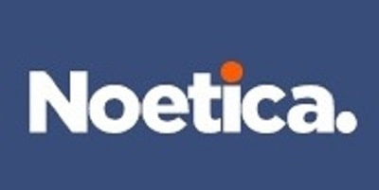





Mitel’s Next Gen Contact Center Portfolio
Outbound Campaign Management
MiContact Center Outbound
Workforce Management
Mitel Workforce Management
Interaction Recording, QM, Speech Analytics
Mitel Interaction Recording
Business Intelligence Analytics
GenAI, AI Virtual Agent / Agent Assist
Workflow Studio
Indirect
&
Direct
Mitel CX
(MiVB)
Mitel CX
(SIP)
or
MiCC Enterprise
Mitel CX
(SIP)
Mitel CX
(SIP)
or
OpenScape Contact Center
Note: MCX will NOT be supported on MiVoice Connect, MiVoice Office 400, or OpenScape Business so those customers will have to migrate to MiVB to get MCX
Mitel CX Solutions
Subscription / CapEx
Deployment Simplicity with Commercial Flexibility
On-Premise / Private Cloud / Public Cloud
Mitel Platforms
MiVoice Business
MiVoice
MX-ONE
MiVoice
5000
OpenScape Voice/4000
Notes:
George presents

Slide 10
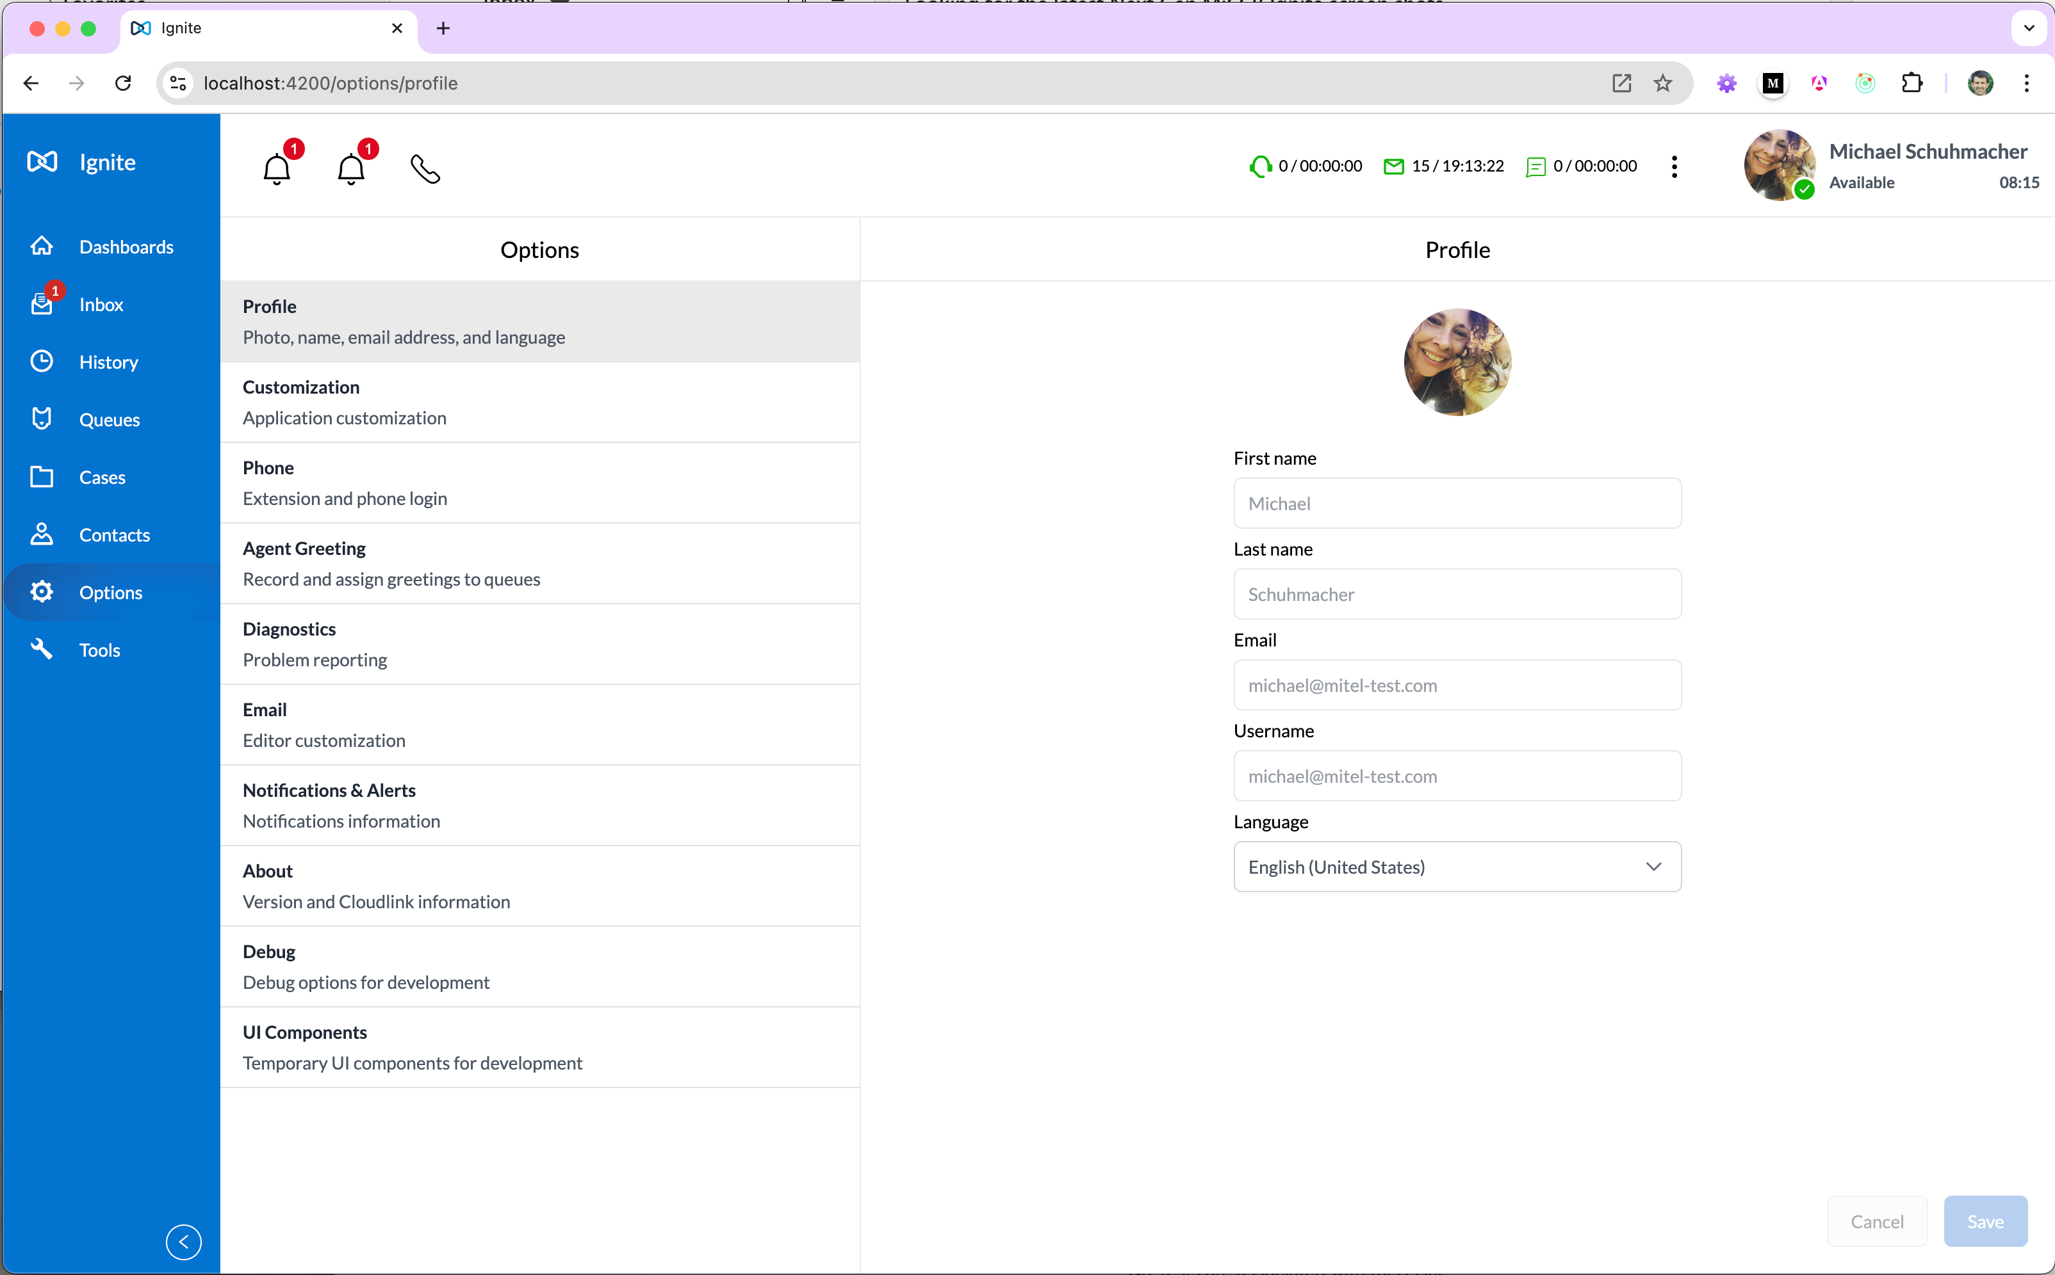

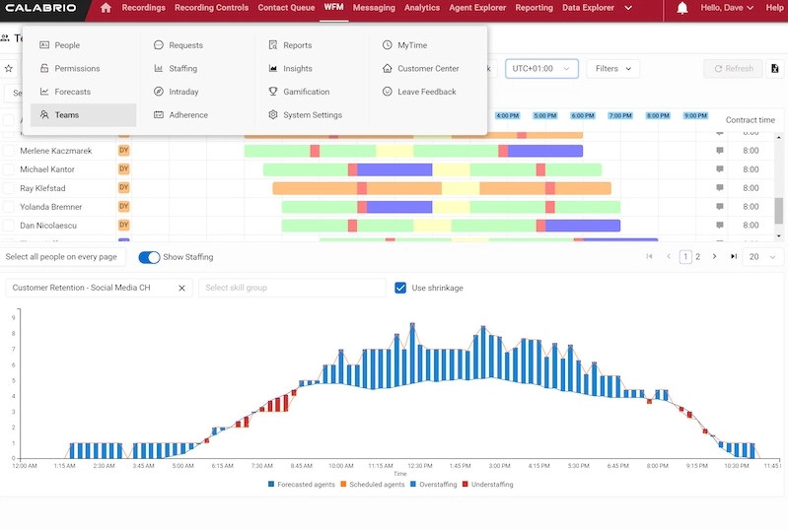
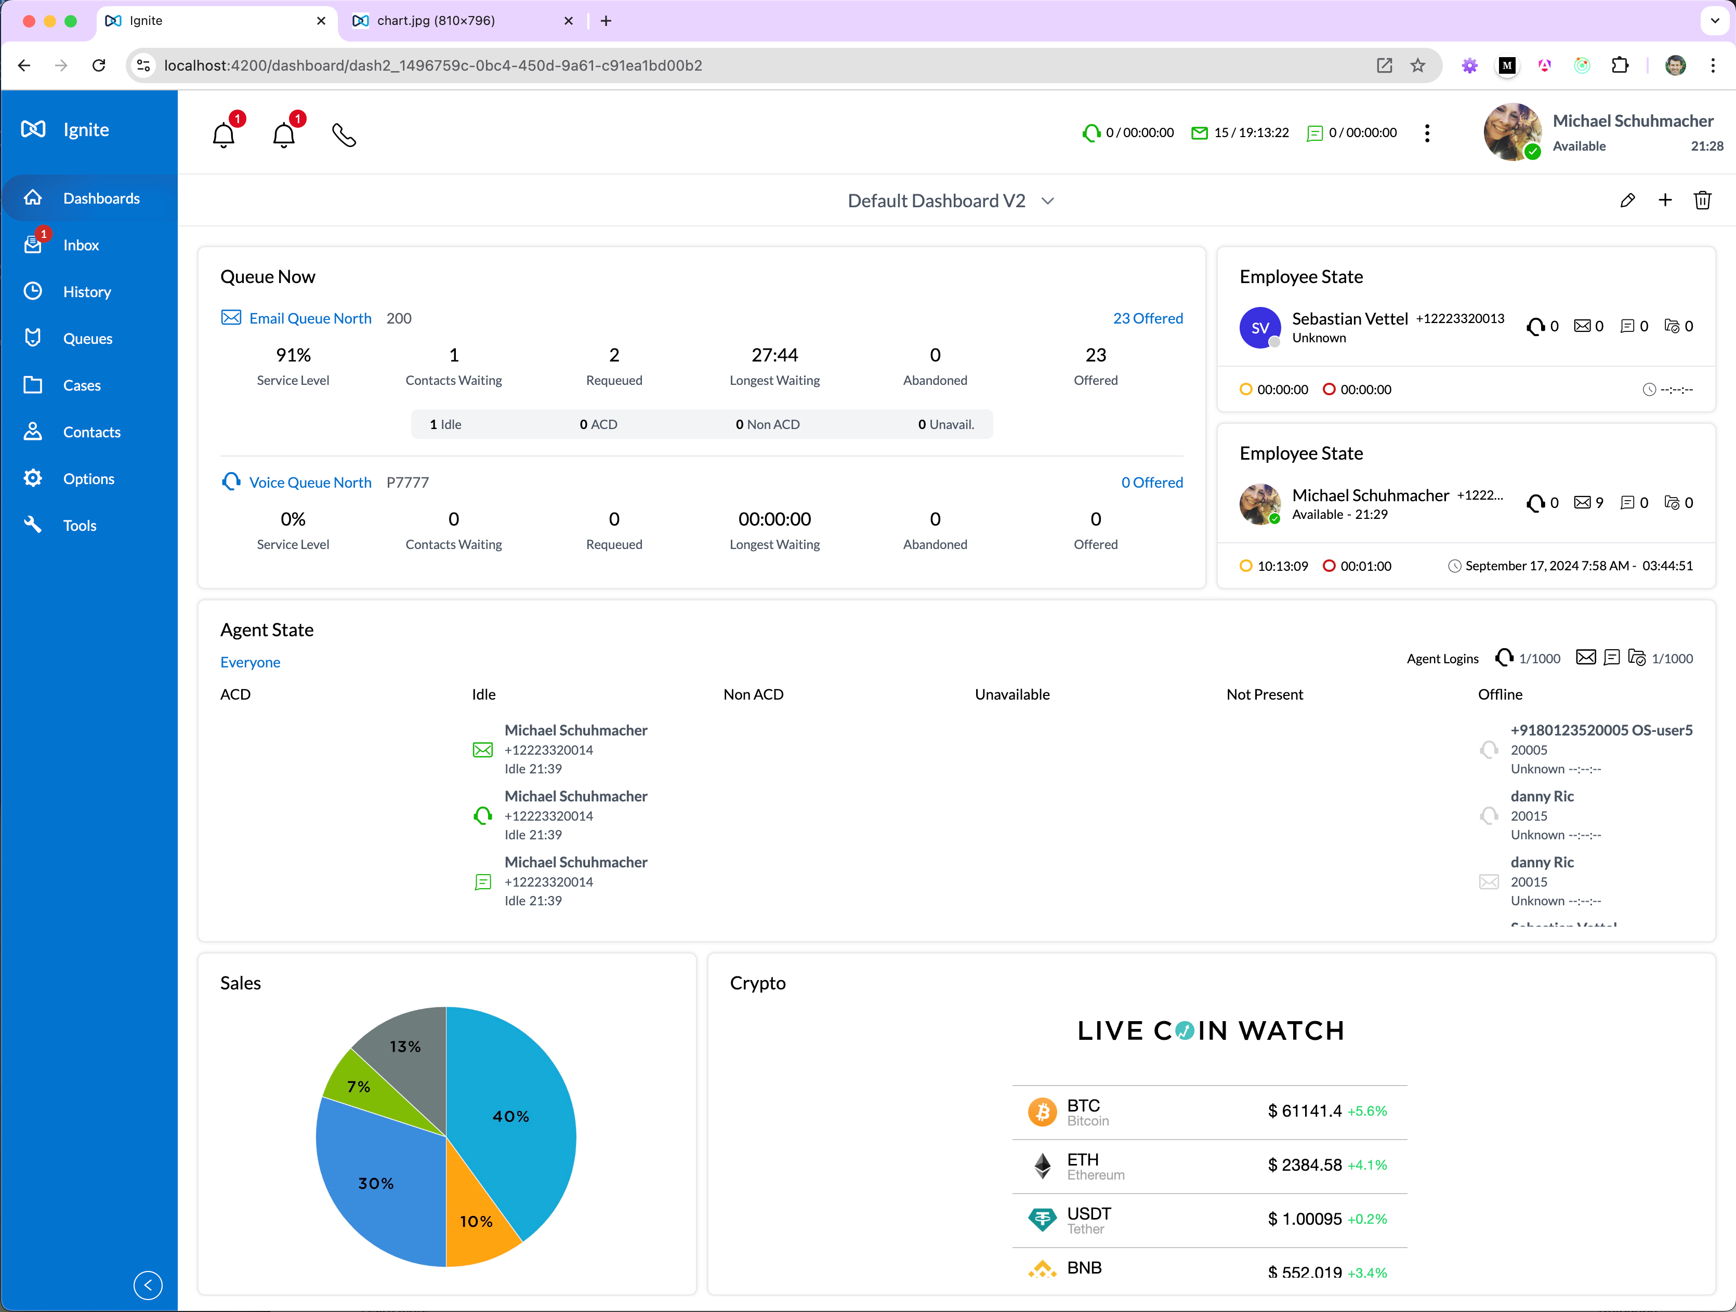


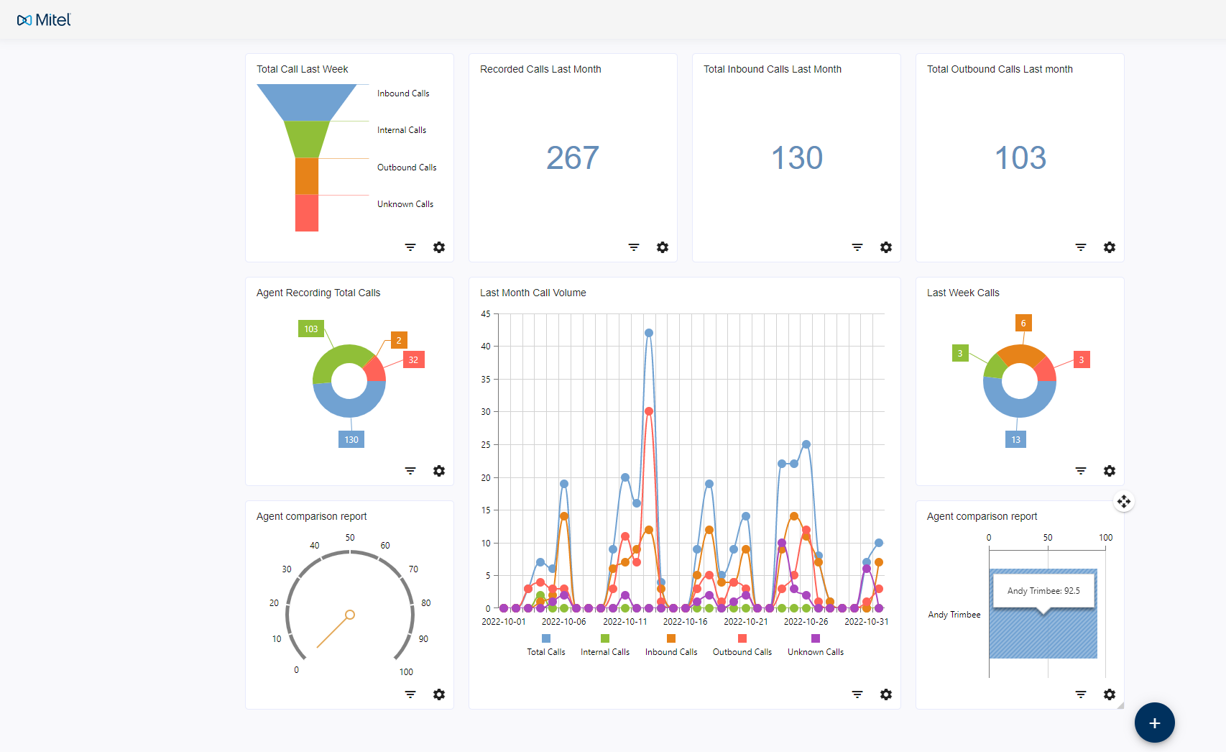


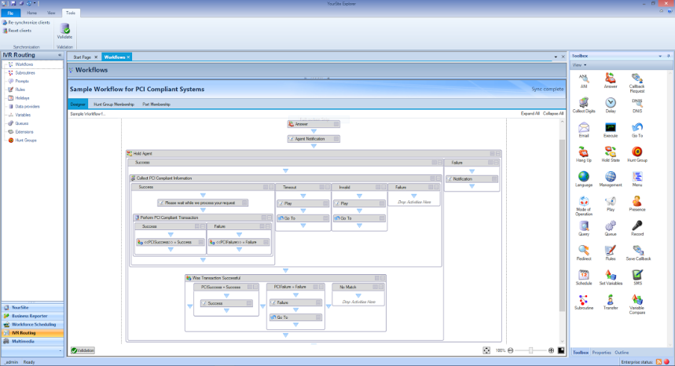


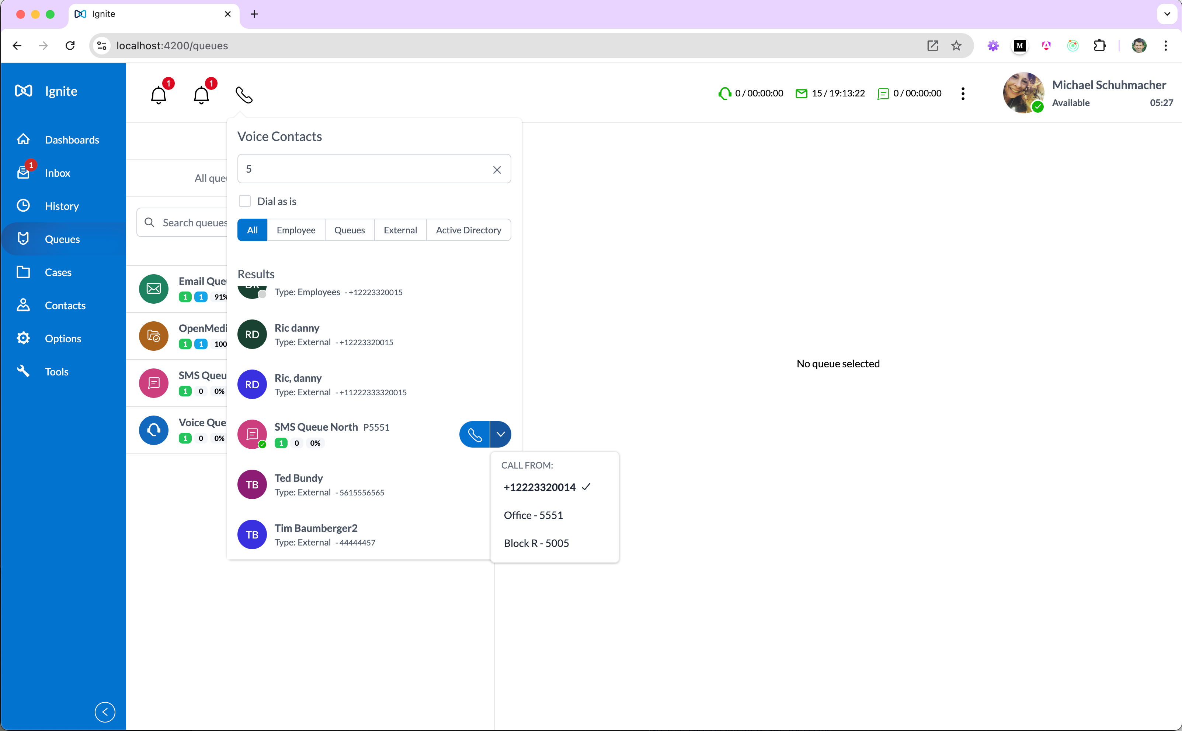
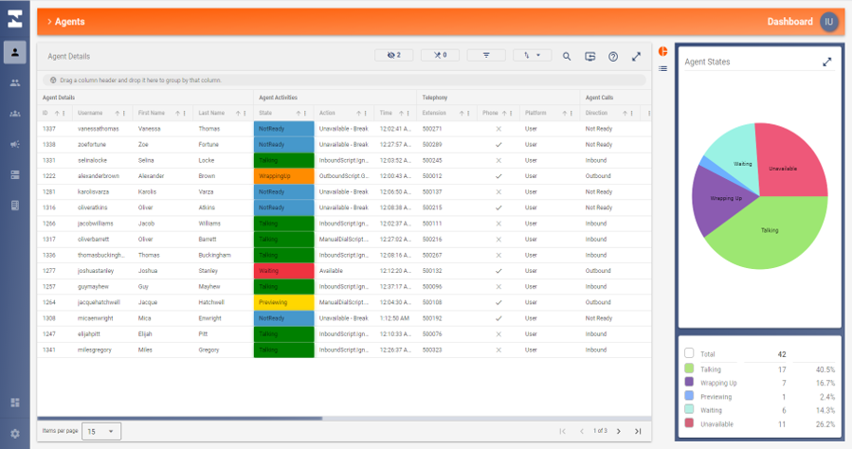


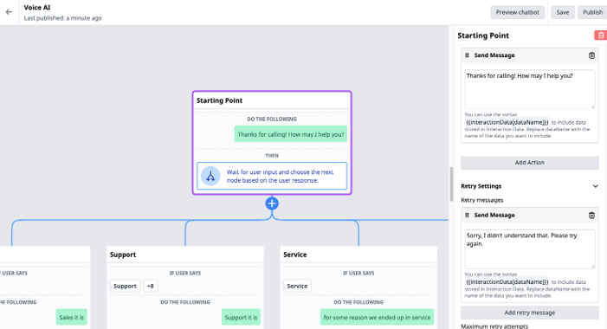
Mitel CX Solution Ecosystem
Mitel WFM
WORKFORCE
MANAGEMENT
INBOUND & OUTBOUND VOICE
REAL-TIME
DASHBOARDS HISTORICAL REPORTING
ANALYTICS
Mitel CX
Mitel Interaction Recording
INTERACTION RECORDING,
QUALITY MANAGEMENT,
SPEECH ANALYTICS
OMNICHANNEL
ROUTING
OPEN MEDIA
SOCIAL
IoT
MiContact Center Outbound
PREVIEW, PROGRESSIVE,
PREDICTIVE DIALING & CAMPAIGN MANAGEMENT
REST API
SCREEN POPS
DATA DIRECTED WORKFLOWS
SELF-SERVICE
AI BOTS / AGENT ASSIST
BIOMETRICS
Notes:
George presents

Slide 11
















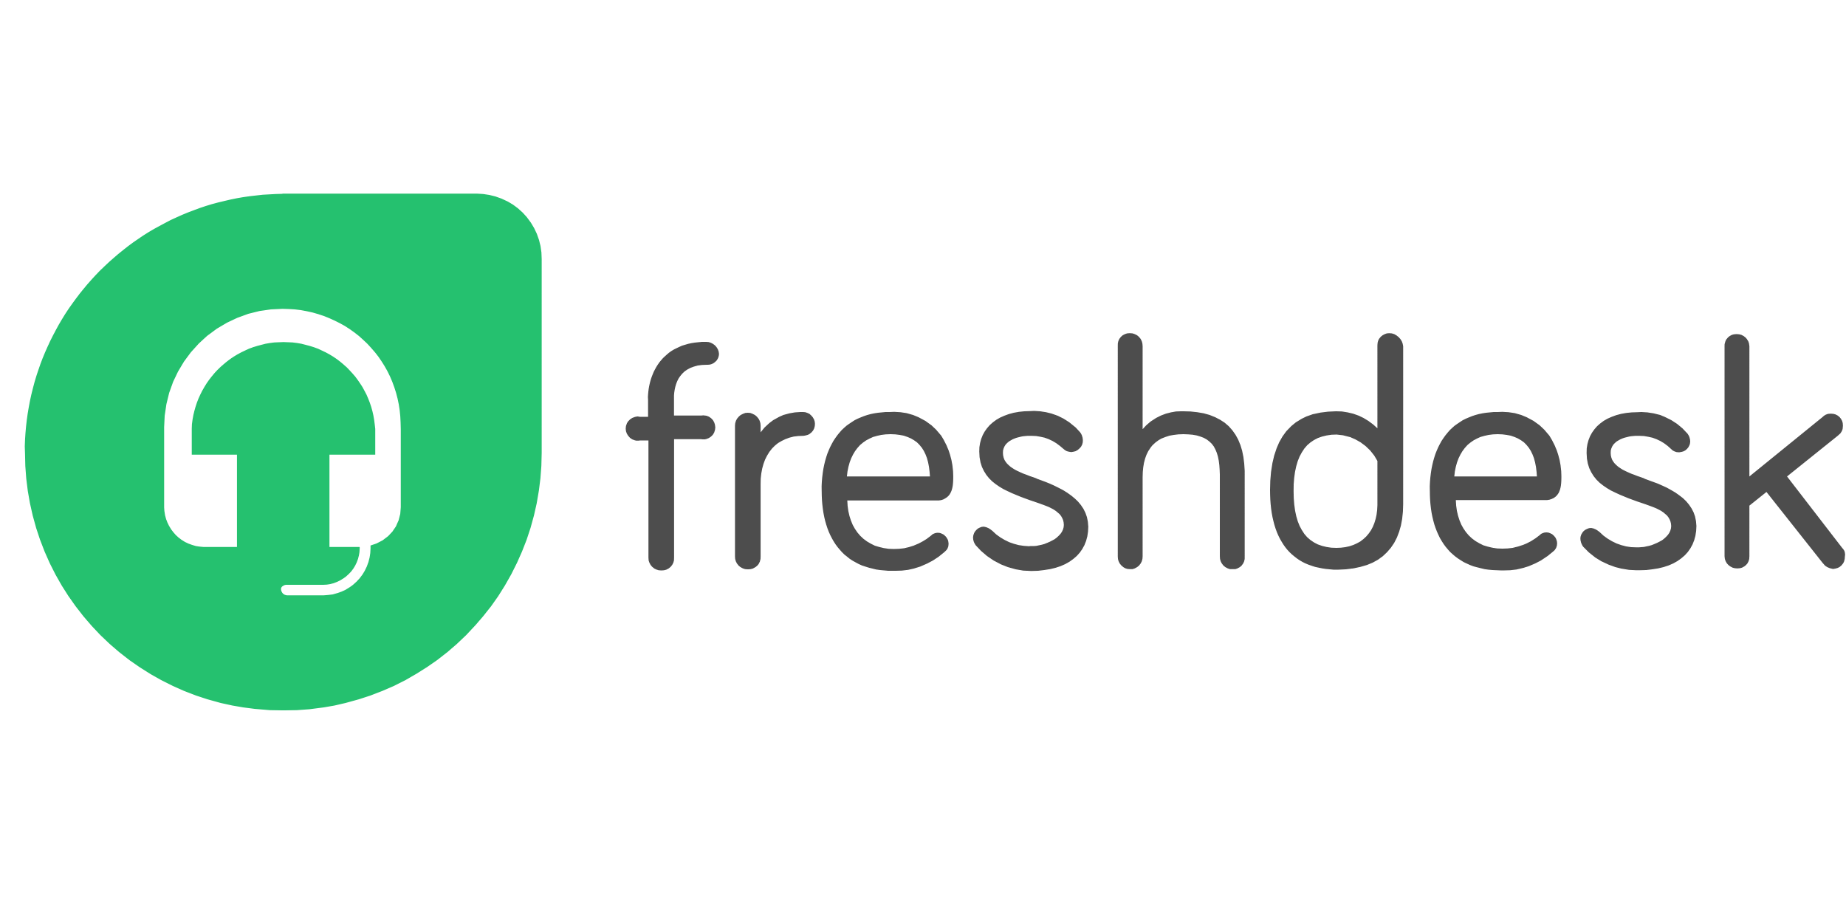






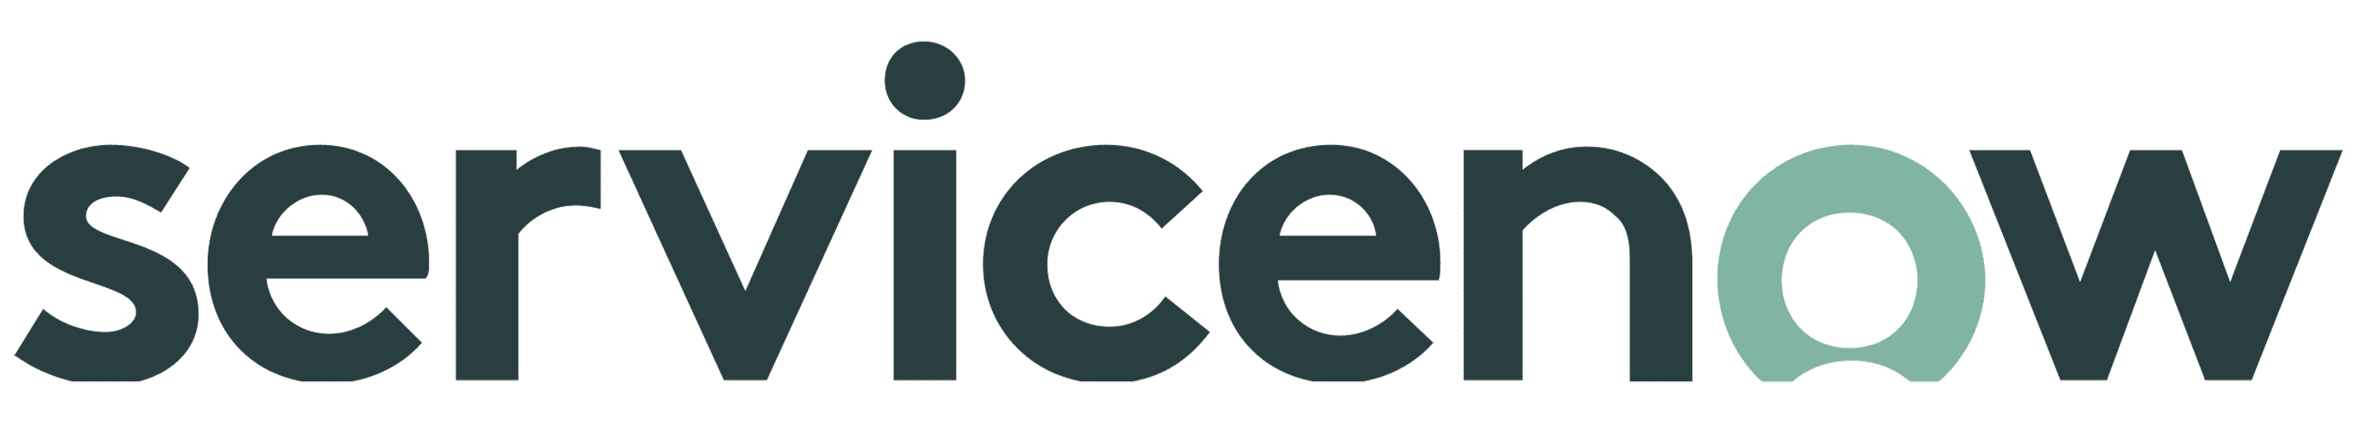





















Mitel CX
INTEGRATIONS
CRM
WFO
Service
Management
PCI
Video &
Cobrowse
Social
Messaging
Platform
Outbound
AI
Speech
Dashboards
BI
Digital Workforce
Notes:
George presents

Slide 12
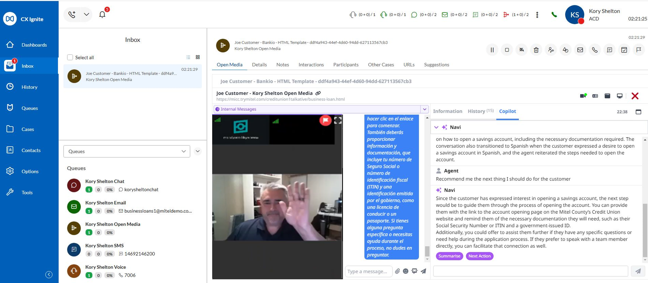
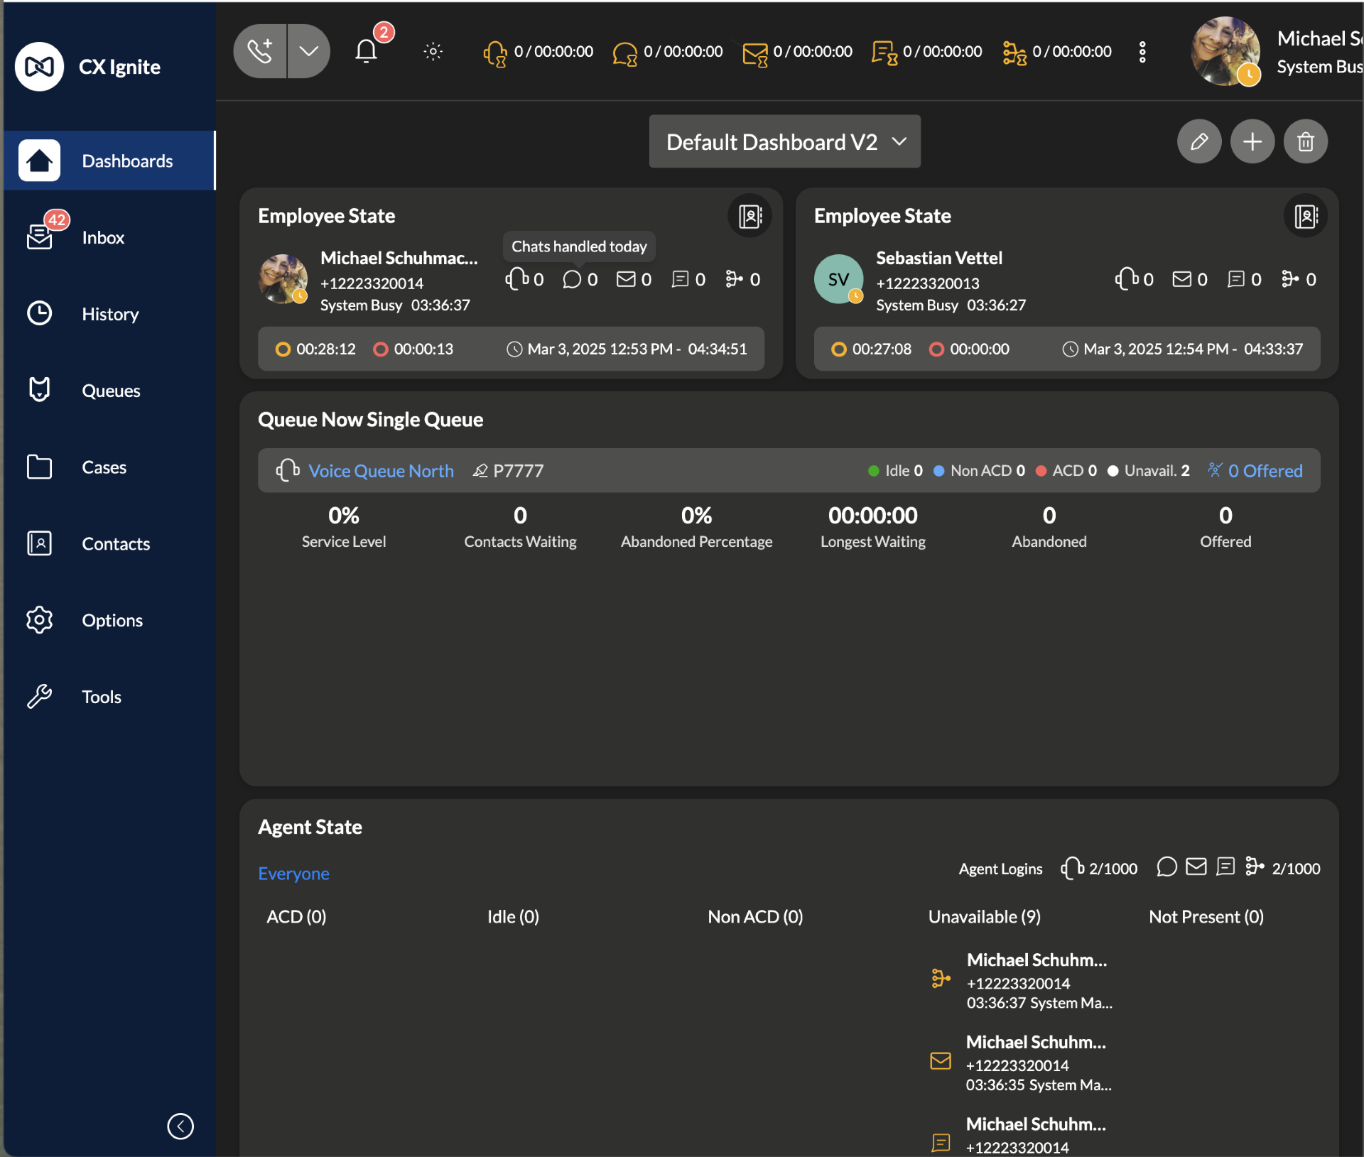
Mitel CX – Integrated, Modern User Experience
Modern UI with fully integrated WebRTC soft phone
Aligns with UI for broader portfolio and provides foundation for seamless UC/CC experience
WCAG 2.2 compliance to meet accessibility standards including Dark mode
Built for Omnichannel / Multi-modal from ground up
Integrated experience for Agents and Supervisors
More flexible dashboards
Light Mode
Dark Mode
Notes:
George presents

Slide 13
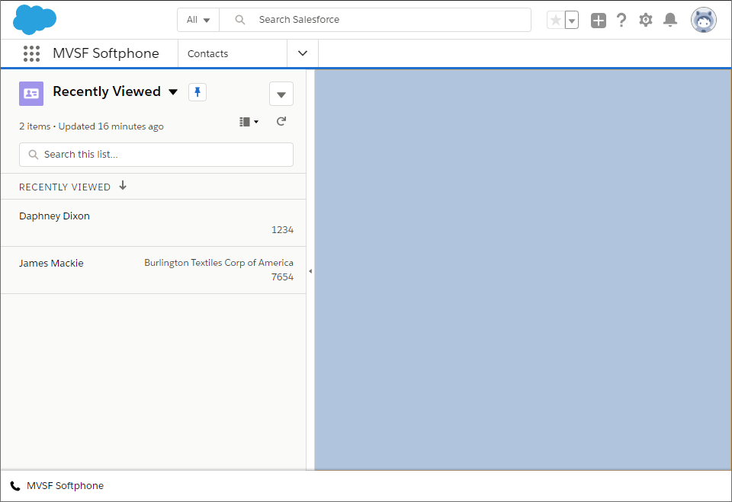
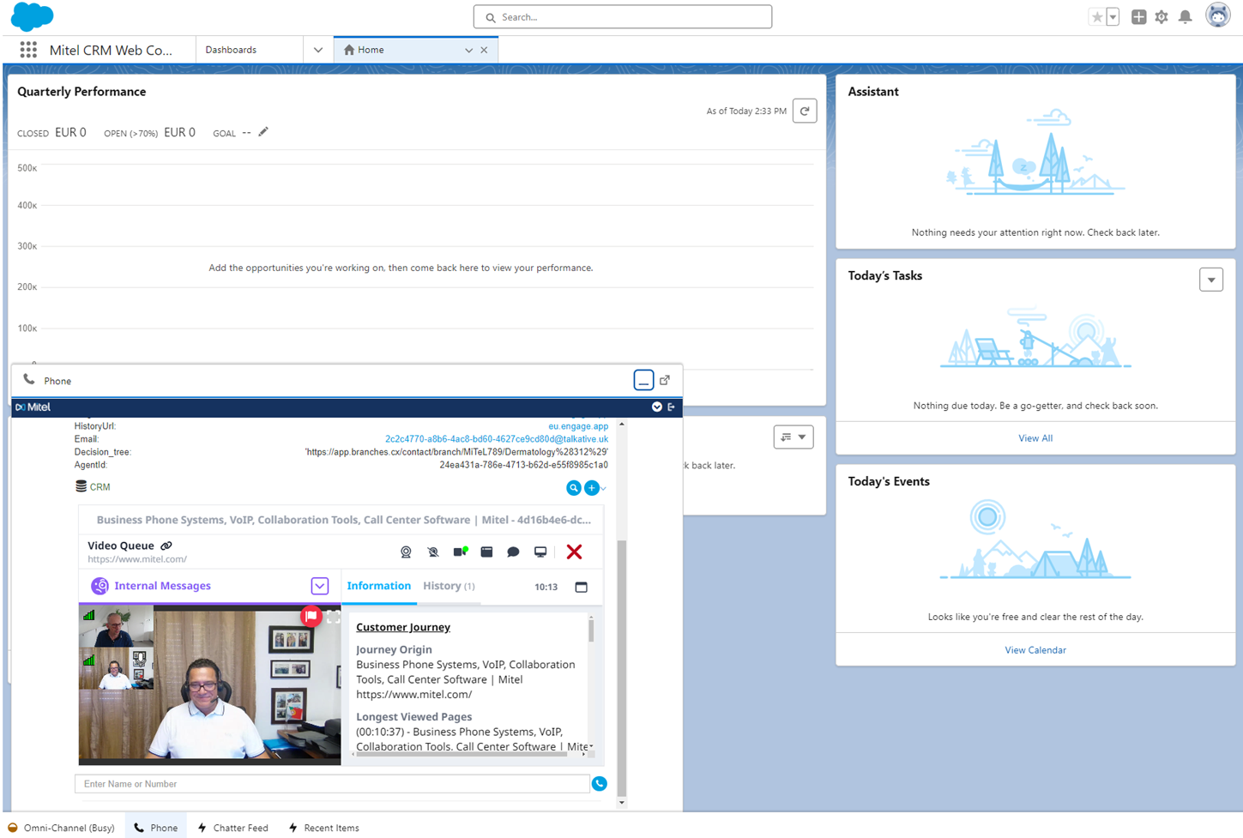
CRM Connector Option
Mitel CRM Connector for Mitel CX integrates communications capabilities with CRM platforms to improve the productivity of agents, reduce costs and enhance the customer experience
Agents can click-to-dial, get screen pops with contextual information and much more
Supported CRM platforms:
Salesforce
Microsoft Dynamics 365 (CRM)
Zendesk
Oracle CX (B2B/B2C)
ServiceNow
The license is part of all the bundle licenses. However, Professional Services is required and is automatically added to the quote in CPQ.
Our PS engineers have the expertise to support many other CRM platforms. Contact Mitel Professional Services to inquire if a certain CRM platform is supported.
Supported channels:
Inbound/Outbound Voice
Email
Chat
SMS
Open Media
Zoho CRM
HubSpot
Odoo
Copper
Notes:
George presents

Slide 14
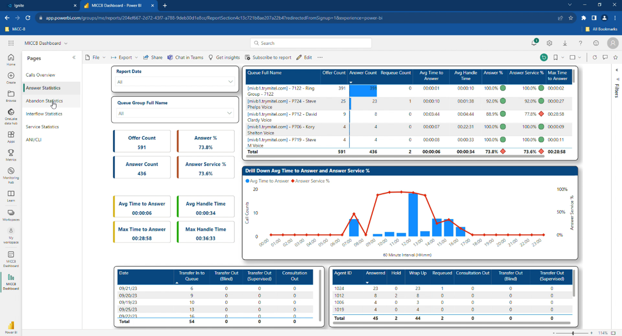

Reporting and Analytics Dashboard via 3rd Party BI Engines
Sample analytics dashboard
Create your own custom dashboards using 3rd party Business Intelligence (BI) engines, such as…
Notes:
George presents
Over the last few years BI tools have become more prevalent to handle the need for more customized reporting. However, not all companies have BI experts. MiCCB has an open API access to the Consolidated Reporting data tables so you can create your own reports and dashboards using common BI tools. We have also created a template for Queue and Queue Group statistics to get you started. This template is available as part of the MiCCB software and on Github where you can see other integrations from your peers.

Slide 15
Product Demo
Notes:
Kory does the demo

