Slide 1

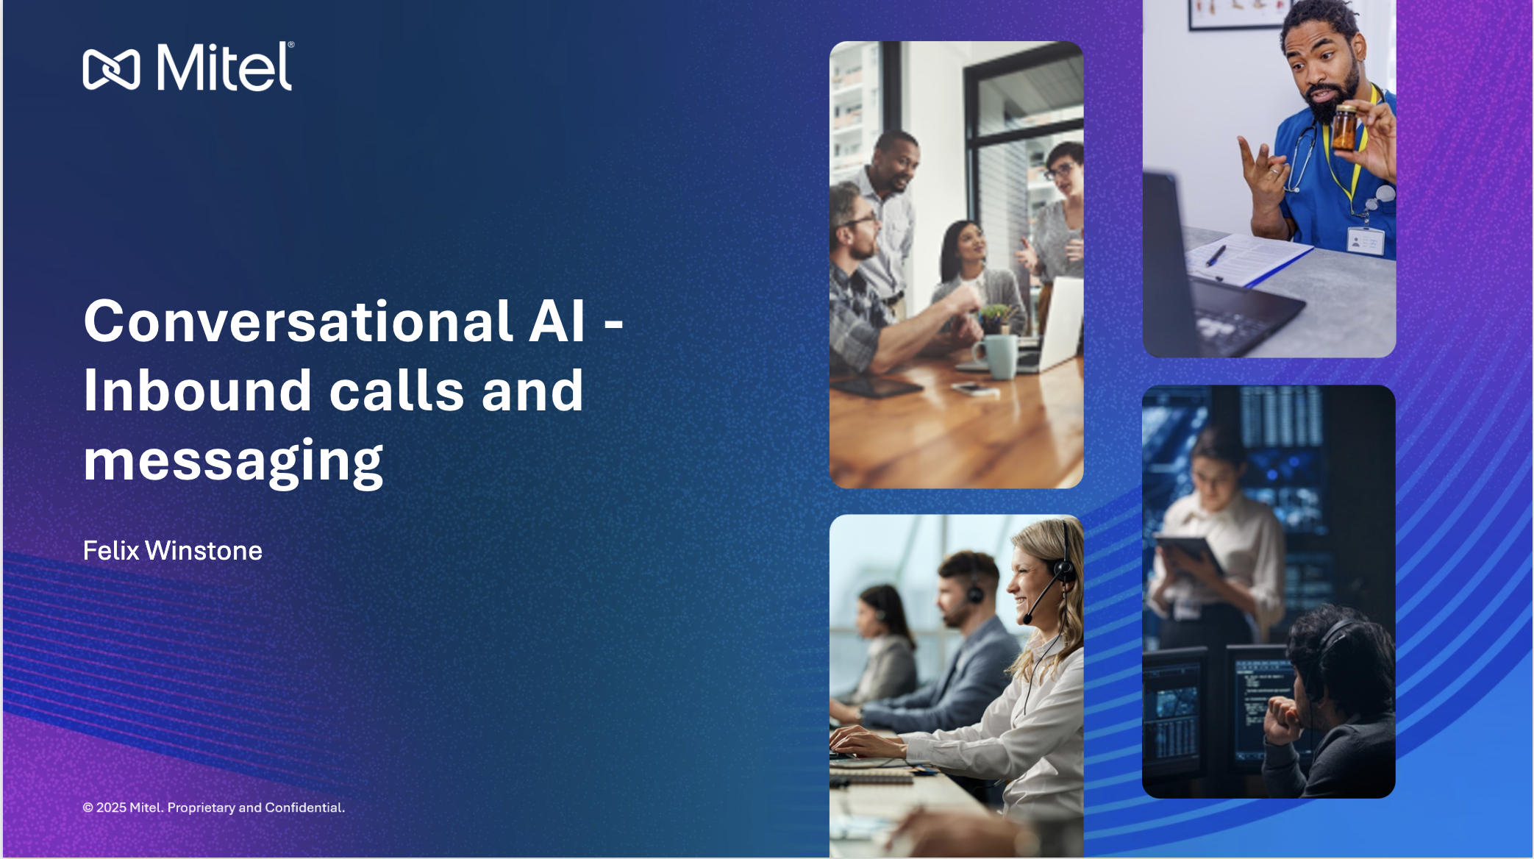


Slide 2



What we will talk about
The Rise of AI
How AI is being used in contact centres
Lessons learned and takeaways

Slide 3
What does it mean for a computer to be intelligent?
Where it all began

Slide 4
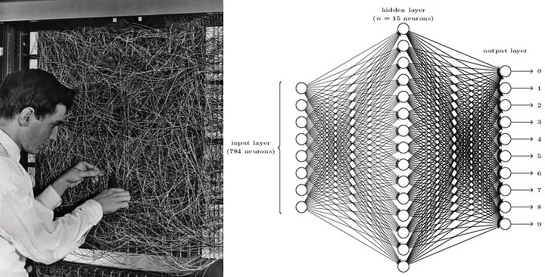
Artificial neural networks were first theorised in the 1940s

Slide 5
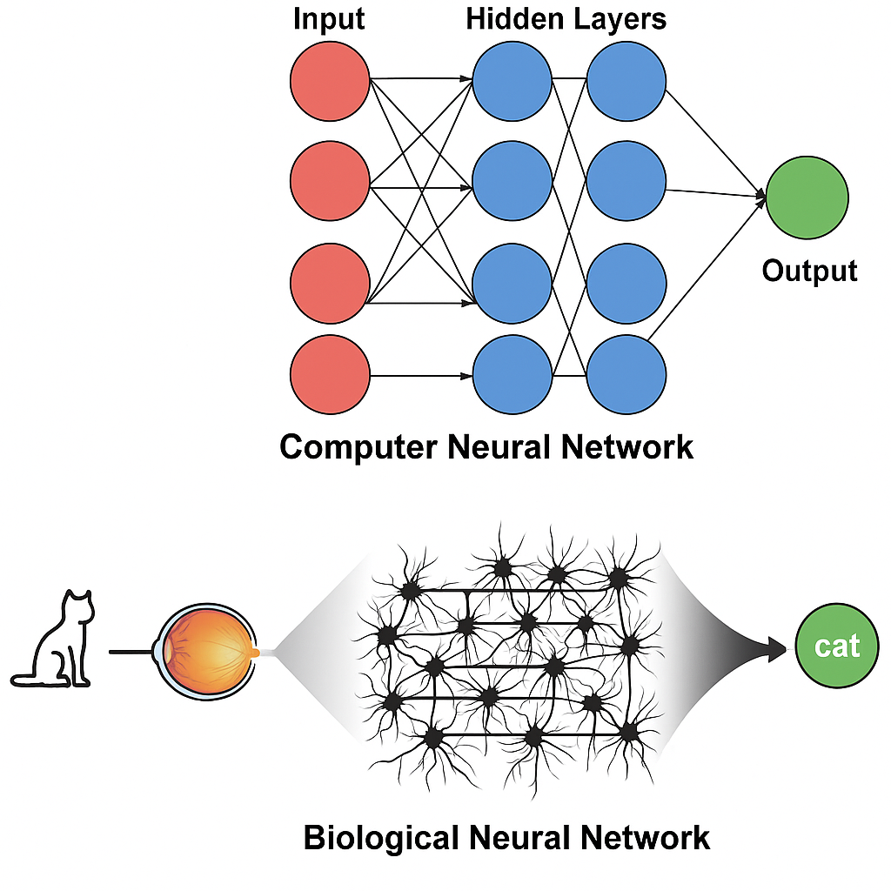
Artificial neural networks are modelled on the human brain

Slide 6

Until recently, neural networks were too small to be useful
But now we have…
Data (the internet)
Compute (GPUs)
Algorithms (the transformer)

Slide 7
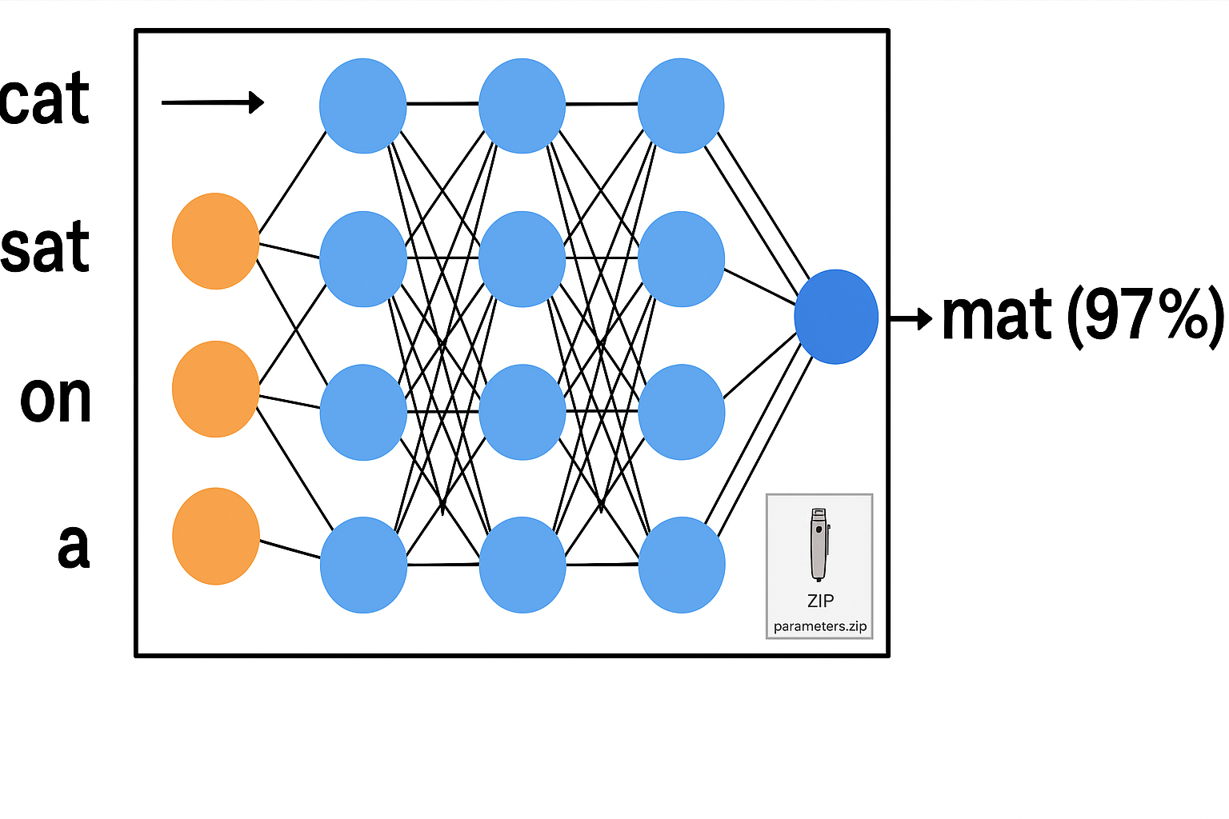
LLM = a neural network that predicts the next word in the sequence

Slide 8
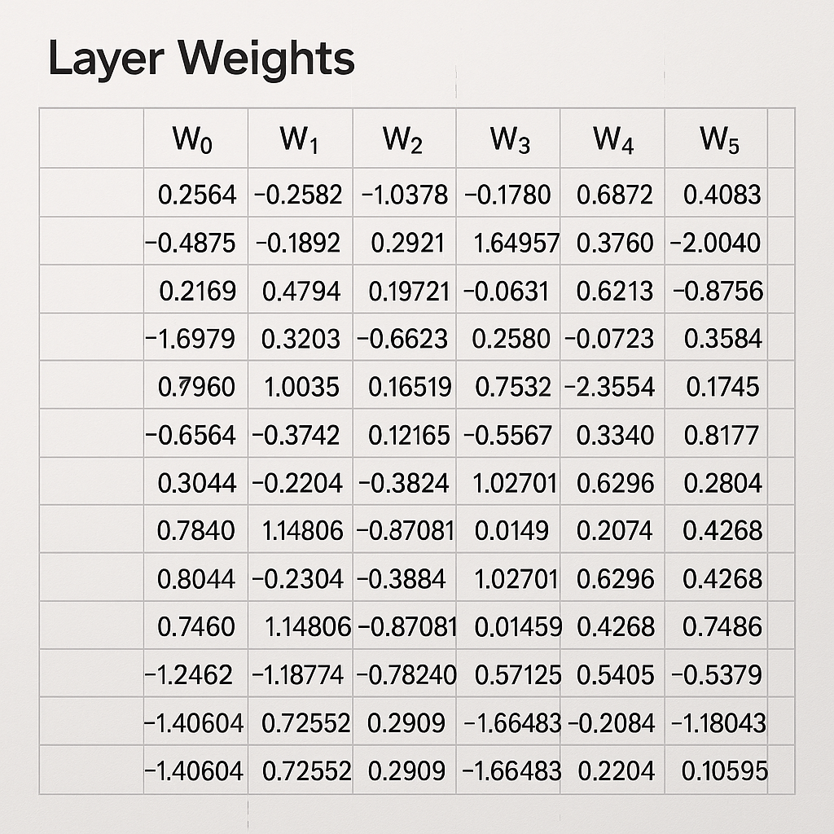
Parameters file is not easily understood

Slide 9



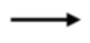
Think of the LLM weights/parameters as a lossy compression of the internet
~10TB internet text
6,000 GPUs for 12 days, $2M
~140GB
*numbers for LLAMA 2 70B

Slide 10
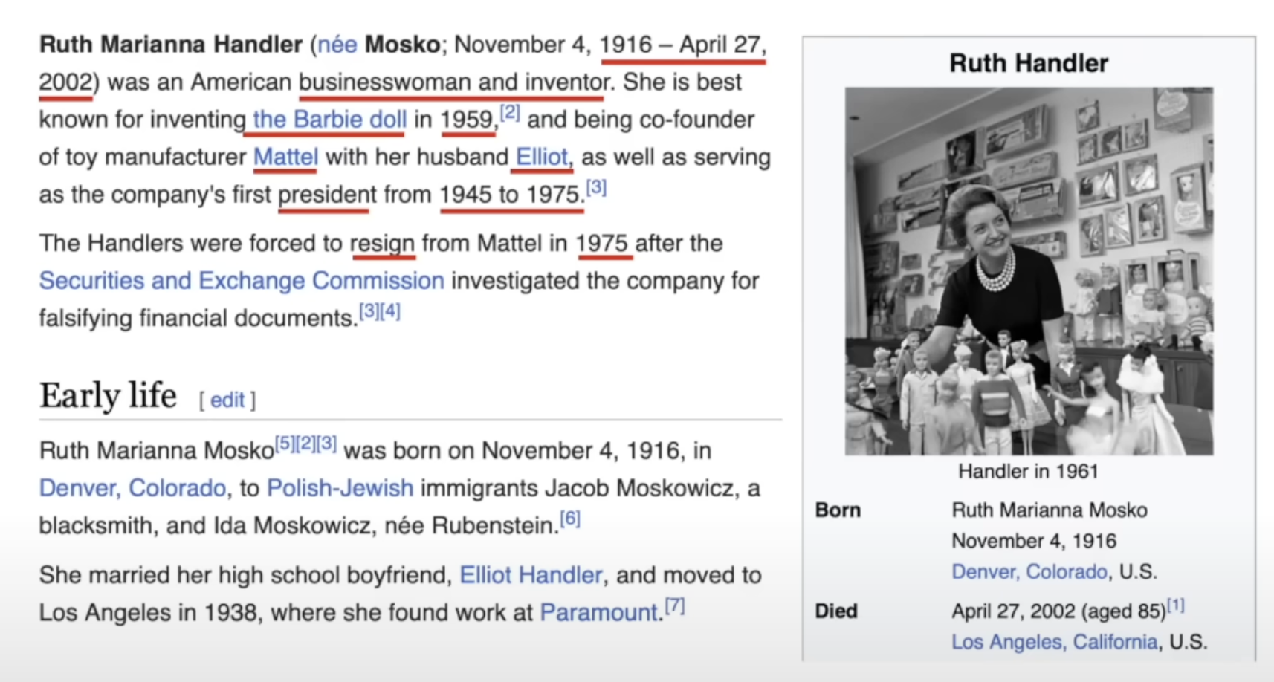
Next word prediction forces the neural network to learn a lot about the world

Slide 11
Why does it work?
We adjust LLMs to better predict the next word
We don’t know how the parameters collaborate
They have an imperfect knowledge database
Example: “reversal curse” Q: “Who is Tom Cruise’s mother”? A: Mary Lee Pfeiffer ✅
Q: “Who is Mary Lee Pfeiffer’s son”? A: I don’t know ❌ 🤔

Slide 12


LLM Key Takeaways
They are great at…
Language understanding
Broad general knowledge
However they…
Have no database
Have no “adaptive” learning

Slide 13
How is AI being used in contact centres?
Customer AI
Agent AI
Supervisor AI

Slide 14
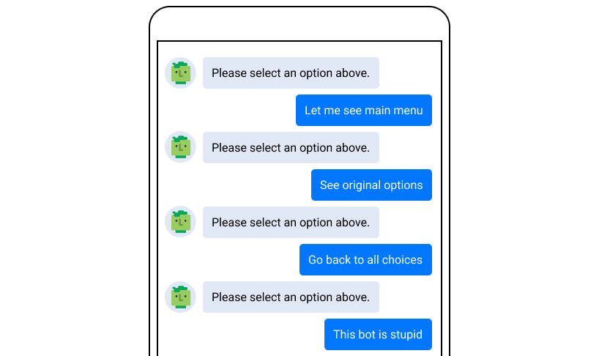
Traditional chatbots are intent based
Pre-written “intent” responses
Inflexible
Difficult to build and maintain
Poor customer experience

Slide 15
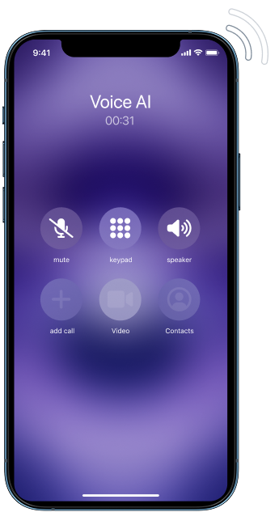
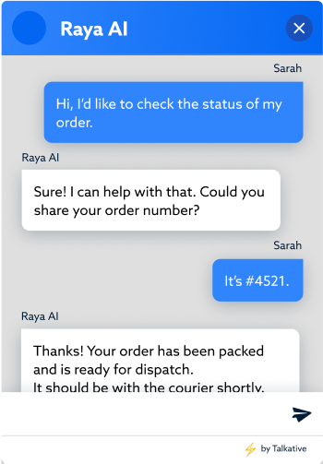
New paradigm = LLM + Knowledge + Tools
True understanding of customer requests
Flexible across languages and channels
Simplified management
High CSAT and clear ROI

Slide 16
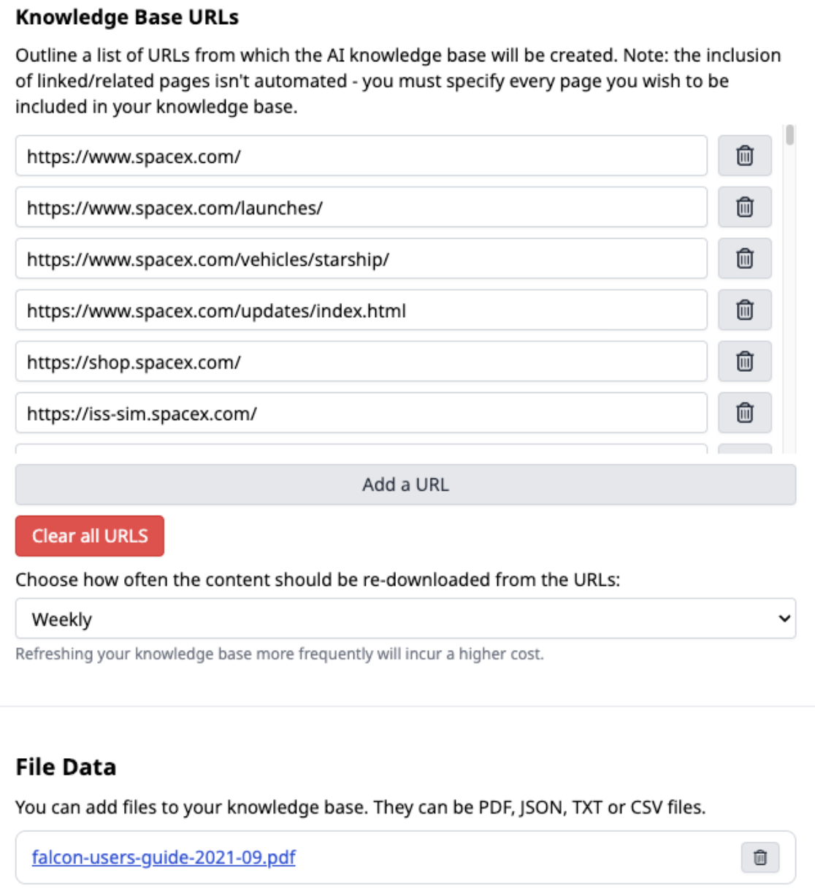
Knowledge base
Provides grounded AI answers
Simple self-serve interface
Reduces hallucinations, like a closed book exam

Slide 17
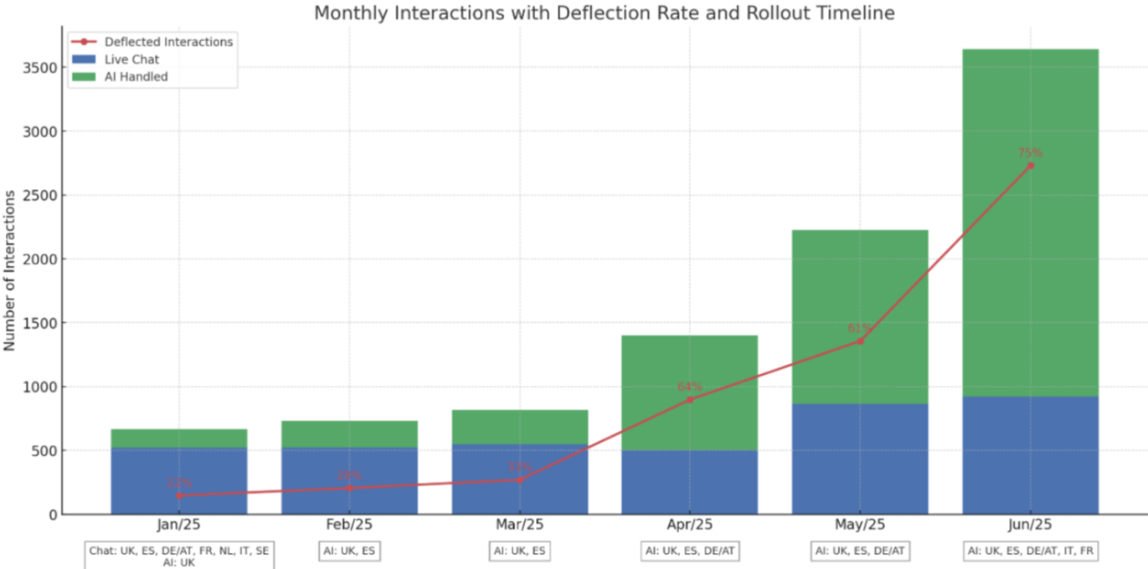
AI Rollout - Bugaboo
LLM introduced here
Notes:
MiContact Center Business deliver a high level of customer experience expertise and credibility! Installed base of >10,000 Mitel MiContact Center systems in over 70 countries!

Slide 18
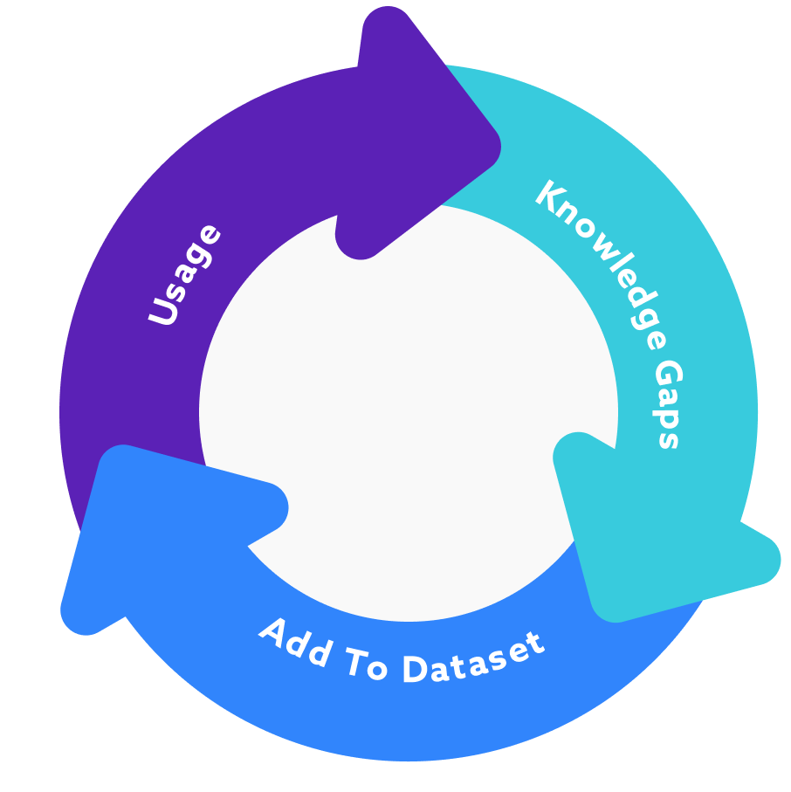
“Does the AI learn?”
Track knowledgebase “misses” and negative sentiment
Summarise common “knowledge gaps”
Create documentation based on human transcripts answers

Slide 19
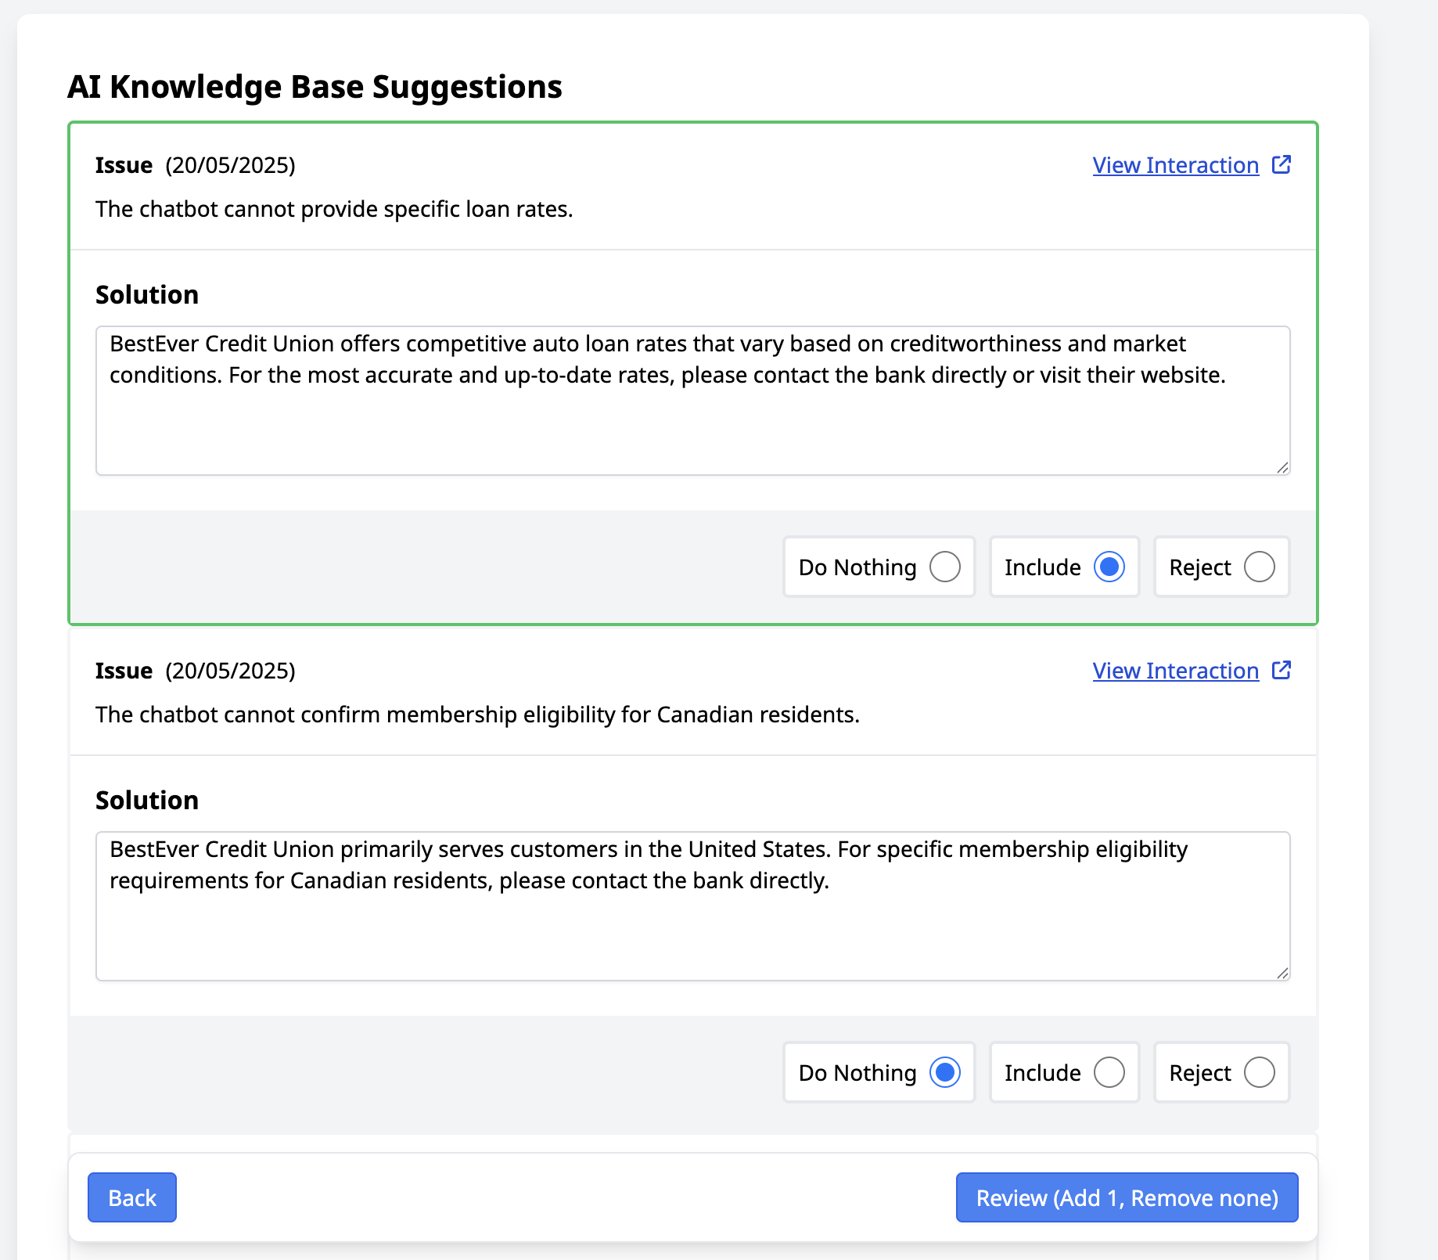

Slide 20
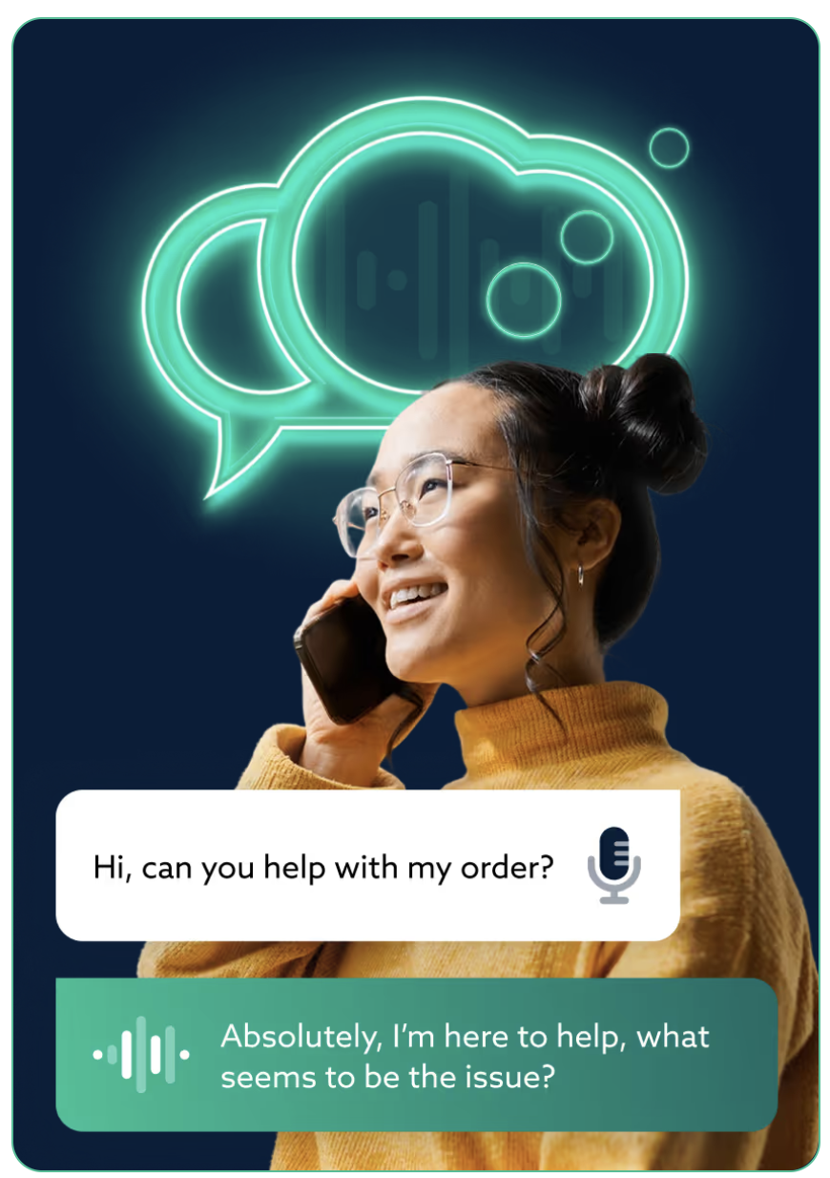
Voice AI
AI Auto Attendant
Route callers to the right queue/agent
Use same knowledge base + tools
Collect key details before transferring
“The AI solution is a no-brainer. It’s mind-blowing to see the responses it gives, and achieving a 88% deflection rate has been massive... It’s changed the way we think about customer service.”
Rob King, IT Manager

Slide 21
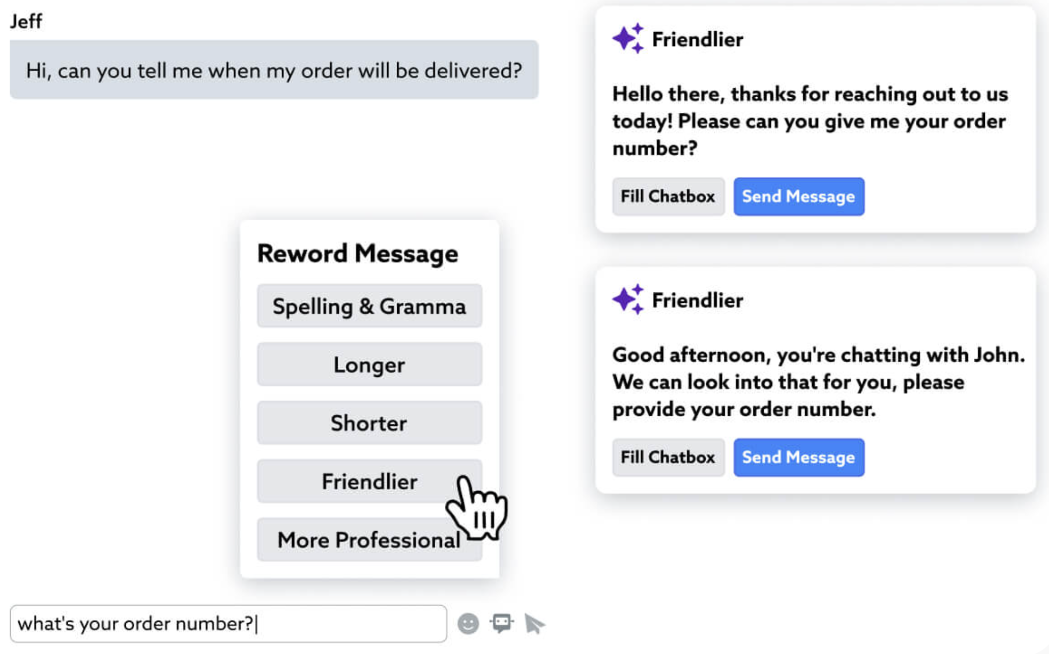
Agent AI
Reduce handle time
Suggested knowledge responses
Auto wrap / tag
Translate and re-phrase
r

Slide 22
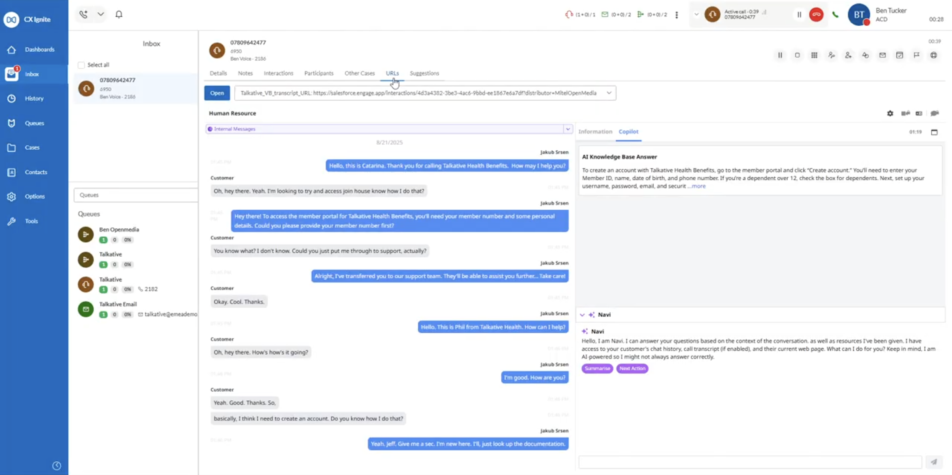

Slide 23
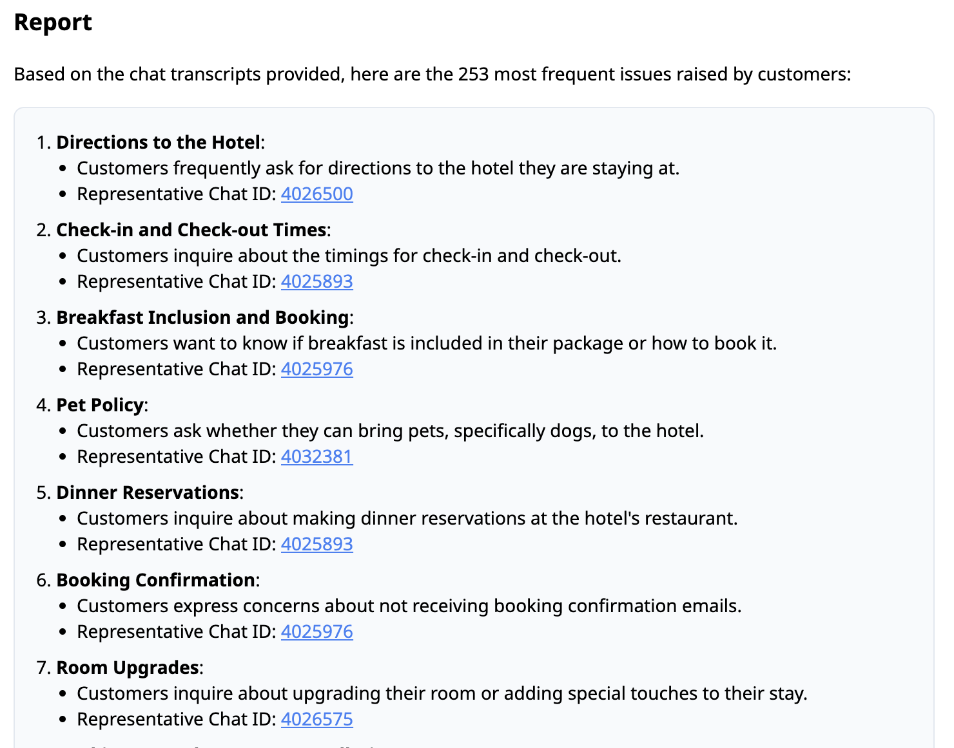
Supervisor AI
Automate QA and get real insights
AI insights across all interactions
AI alerts
Suggested knowledgebase improvements

Slide 24
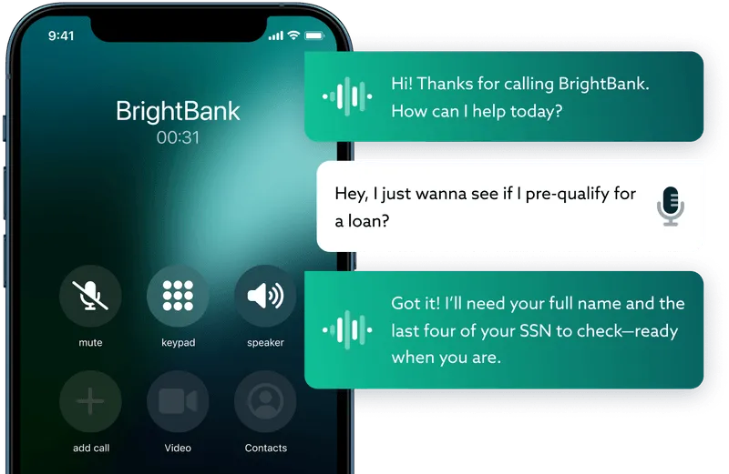
Solution Recap
Customer-Facing Channels
Voice, chat, SMS
Knowledge base and tools
Agent Handoff
Intelligently pass calls/chats to agents
AI agent assist on chat and voice
Easily Deployed
Extensive analytics and AI insights
Build your knowledge base over time
Notes:
Support for Microsoft Exchange, Exchange Online, and Gmail (IMAP-based email servers)

Slide 25



Product Direction
KB
Prompt
Tools
One AI brain, across channels

Slide 26
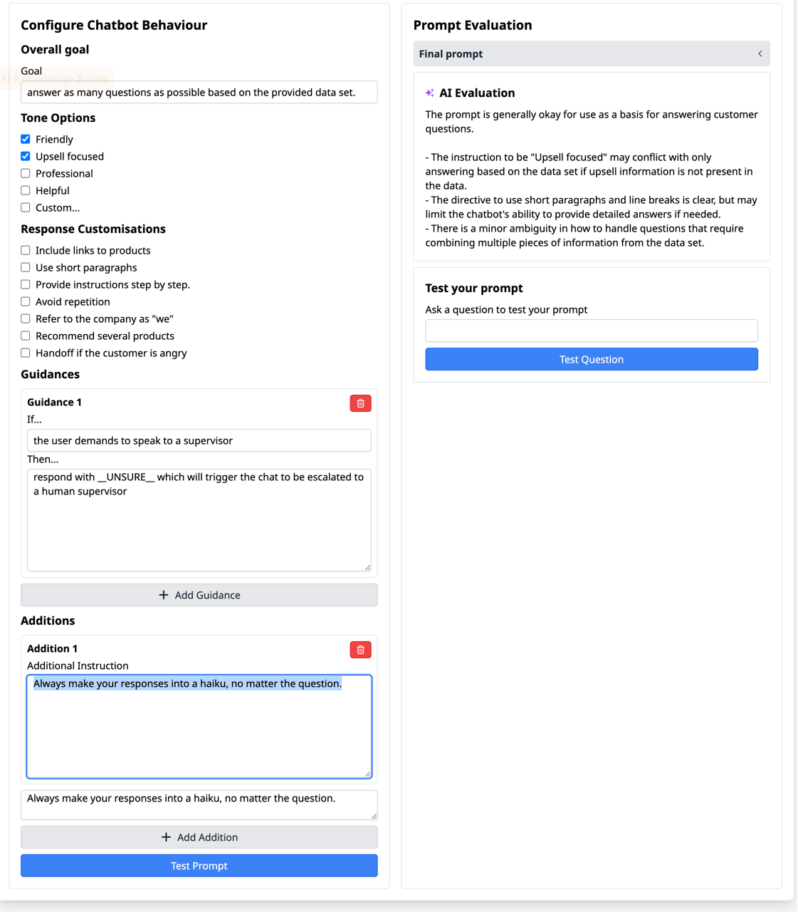
In Development
Knowledge Management
Enhanced test suite
AI agent assist on chat and voice
Prompt Management
Visual prompt builder
AI grader and suggestions
Tool Management
Enhanced chat tooling
Pre-built connector library

Slide 27
How to get started?
“I know AI can help but it sounds like a lot of work”
“I don’t know what quality my data is in”
“AI seems new and we don’t have the skills in house”

Slide 28
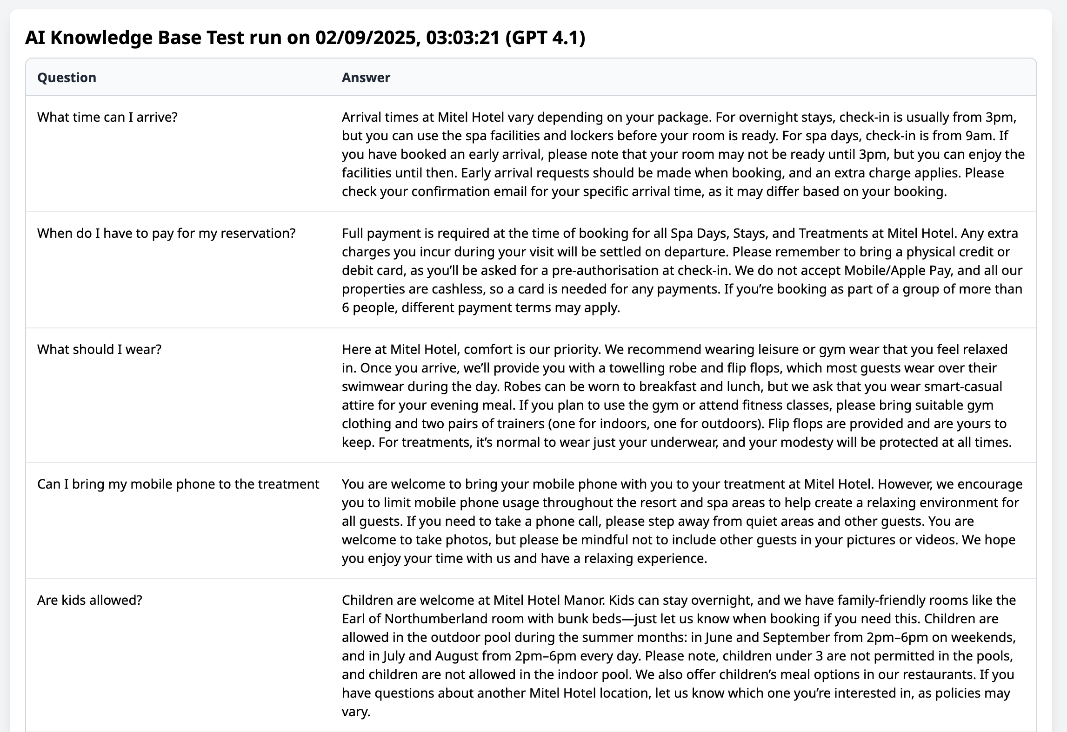
AI Readiness Program - go from zero to “I’m confident!”
Expertise
Our team will guide you through
Interactive workshops
Tools
AI test suite
Knowledge base analytics
Knowledge
Your participation, your knowledge
Learn key skills for the AI age
Notes:
Support for Microsoft Exchange, Exchange Online, and Gmail (IMAP-based email servers)

Slide 29
Key Takeaways
AI success is built off knowledge base and prompts
Human supervision is key
Start small today, and grow over time

